Slide 1






Neuromorphic computing
with thermal interactions
Yuanhang Zhang
12/23/2023

Slide 2

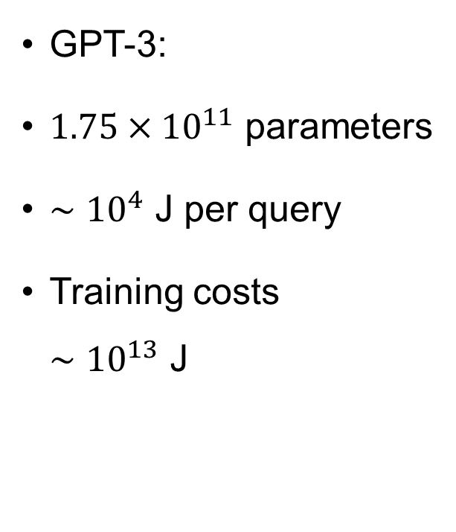
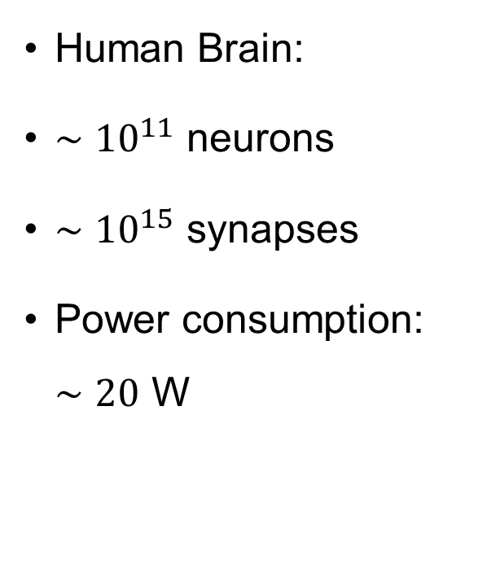
Neuromorphic computing
Human Brain:
$∼{10}^{11}$ neurons
$∼{10}^{15}$ synapses
Power consumption: $∼20$ W
GPT-3:
$1.75×{10}^{11}$ parameters
$∼{10}^{4}$ J per query
Training costs $∼{10}^{13}$ J
Marković, D., Mizrahi, A., Querlioz, D., & Grollier, J. (2020). Physics for neuromorphic computing. Nature Reviews Physics, 2(9), 499-510.
Patterson, David, et al. "Carbon emissions and large neural network training." arXiv preprint arXiv:2104.10350 (2021).

Slide 3
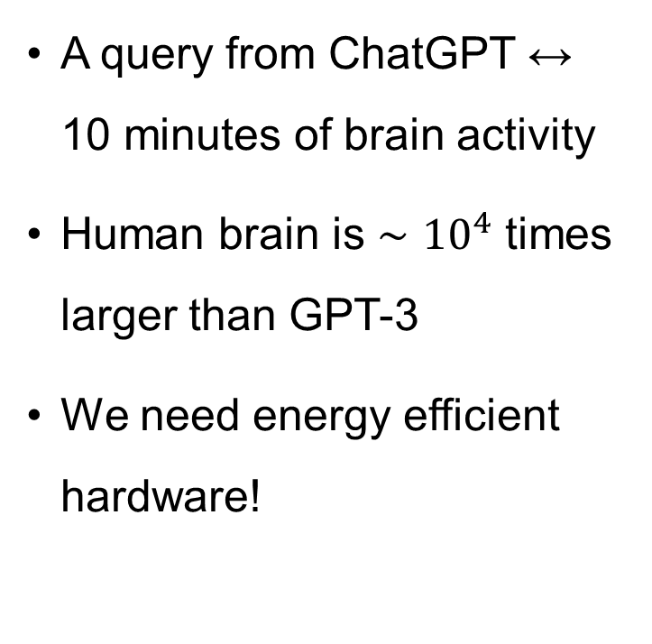
Neuromorphic computing
A query from ChatGPT $↔$ 10 minutes of brain activity
Human brain is $∼{10}^{4}$ times larger than GPT-3
We need energy efficient hardware!

Slide 4

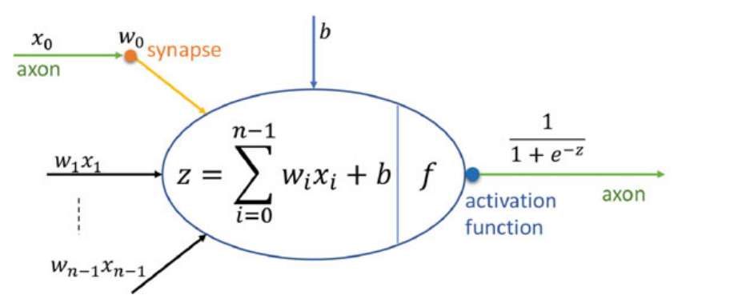
Neuromorphic computing
Abdallah, Abderazek Ben, and Khanh N. Dang. Neuromorphic computing principles and organization. Berlin: Springer, 2022.

Slide 5
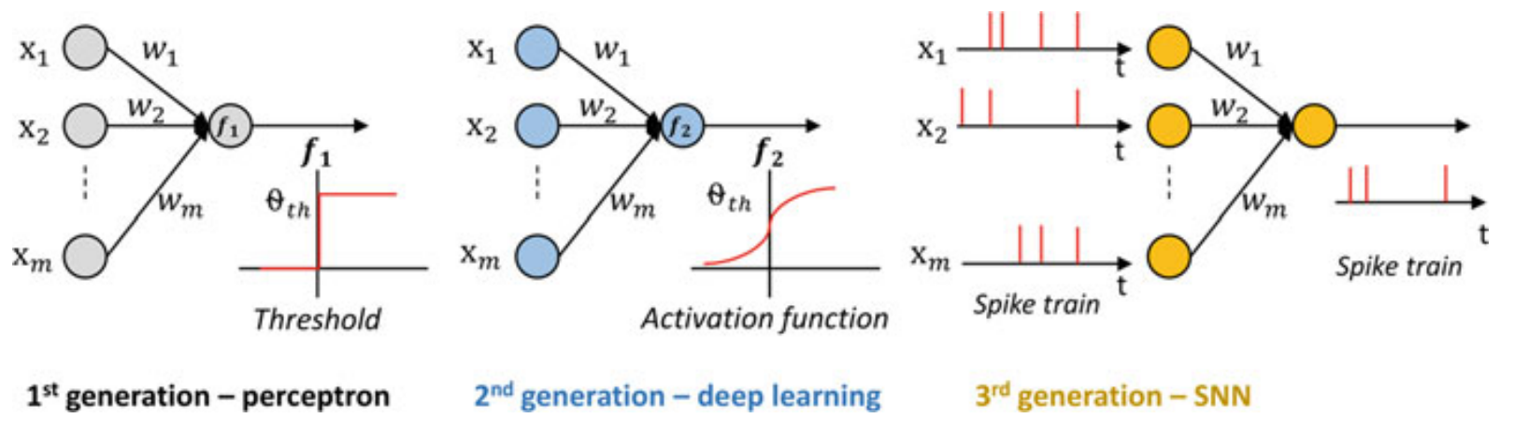
Neuromorphic computing
Abdallah, Abderazek Ben, and Khanh N. Dang. Neuromorphic computing principles and organization. Berlin: Springer, 2022.

Slide 6
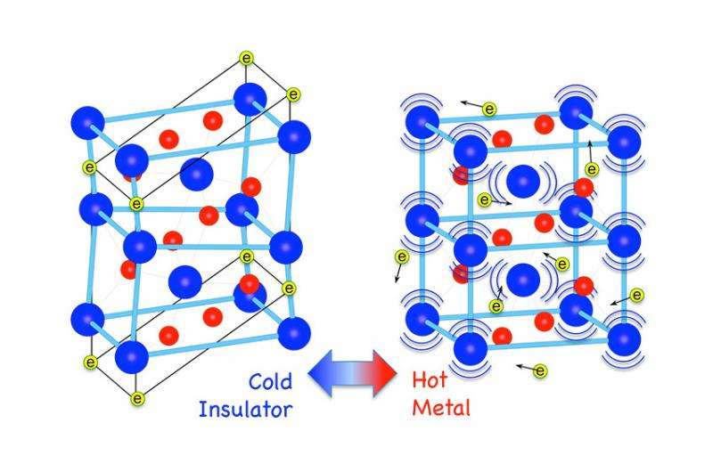
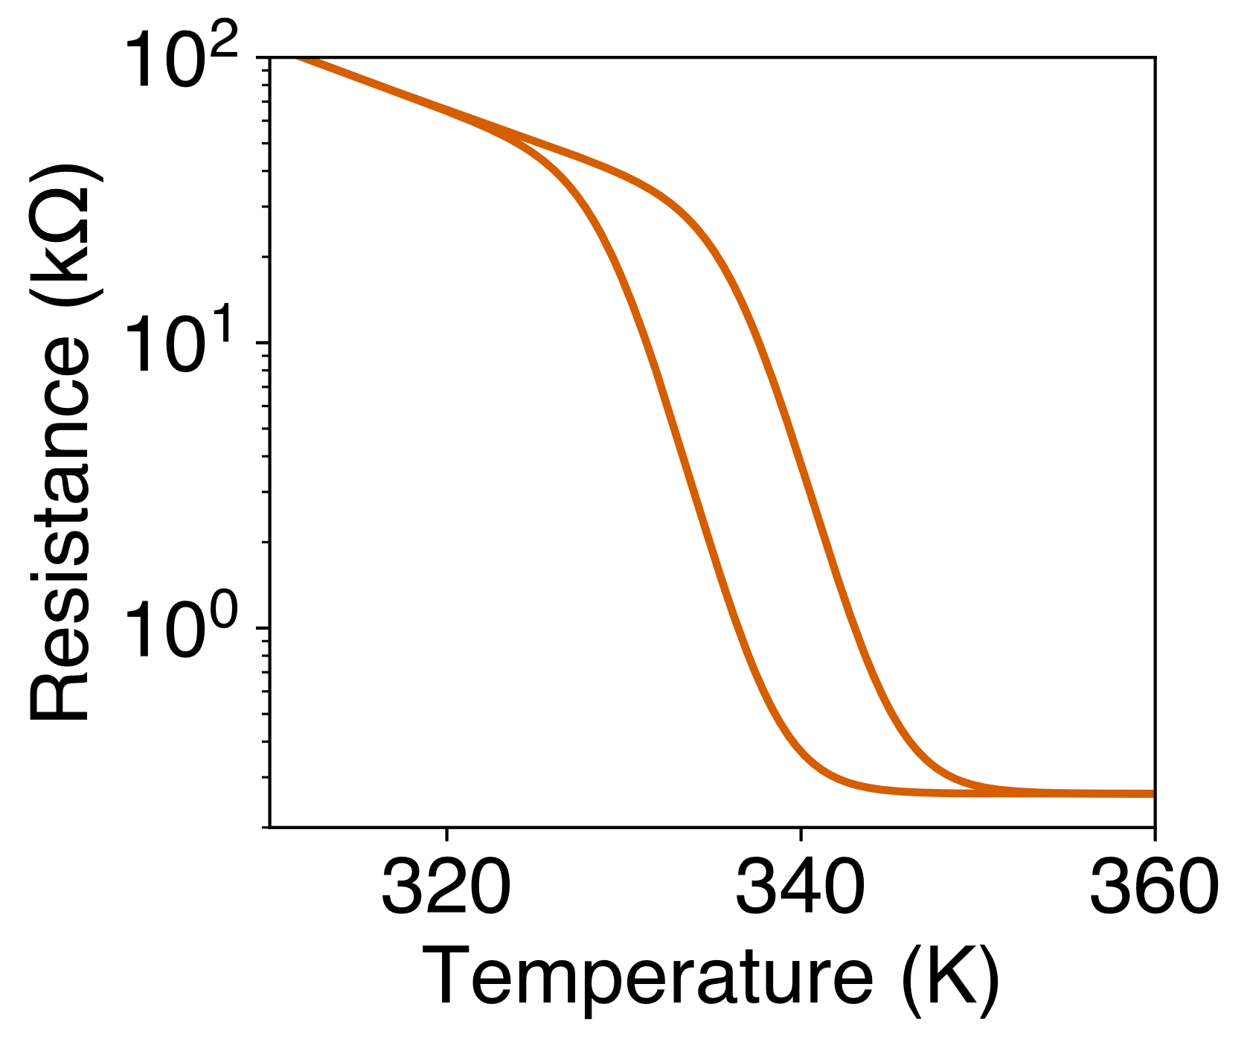
Vanadium dioxide
Insulator-to-metal transition: $T_{c}≈340K$
Insulating State
Heating
Cooling
Metallic State
Image credit: https://phys.org/news/2015-04-insulator-to-metal-transition-vanadium-dioxide.html
Budai, J. D., Hong, J., Manley, M. E., Specht, E. D., Li, C. W., Tischler, J. Z., ... & Delaire, O. (2014). Metallization of vanadium dioxide driven by large phonon entropy. Nature, 515(7528), 535-539.

Slide 7
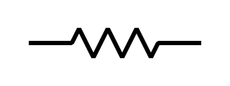
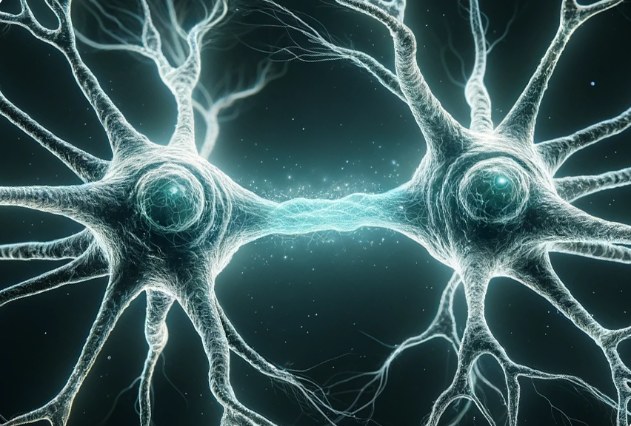
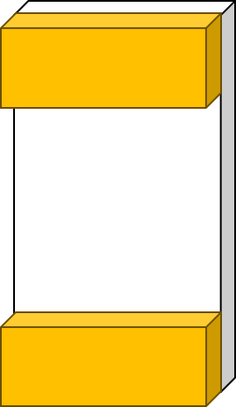
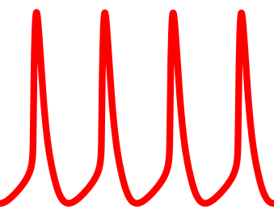

Thermal Neuristor
V^{in}
Thermal Interaction
R^{load}
Ti/Au
Electrode
V
VO₂
VO₂
Heat
Spikes
R
C
500 nm
Electrode
Substrate: Al₂O₃
Qiu, E., Zhang, Y. H., Di Ventra, M., & Schuller, I. K. (2023). Reconfigurable cascaded thermal neuristors for neuromorphic computing. Advanced Materials, 2306818.

Slide 8
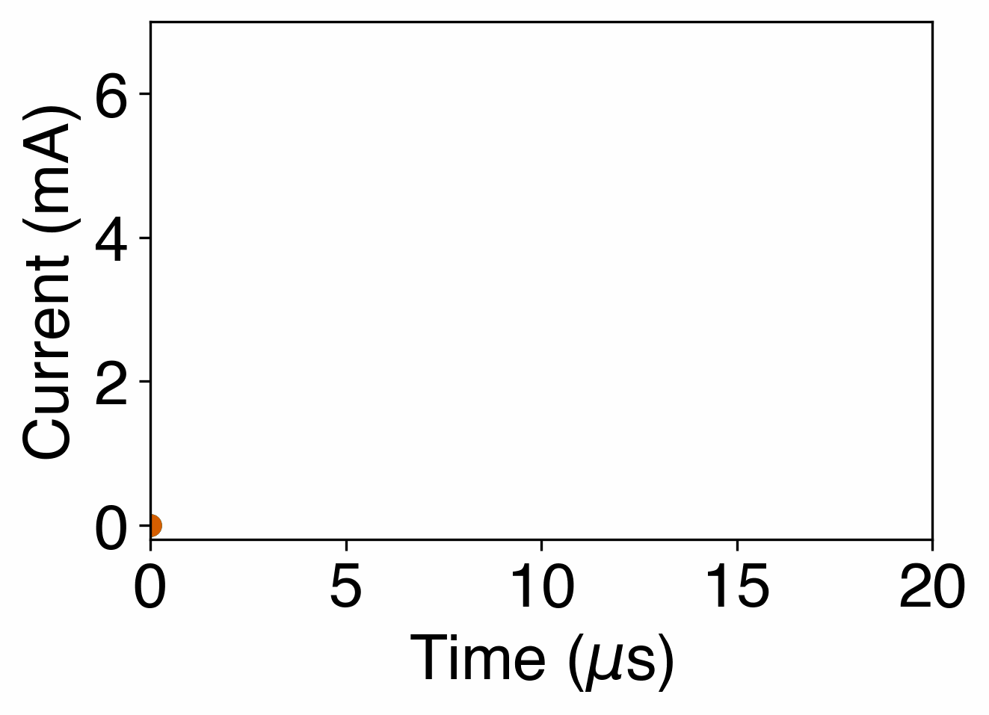
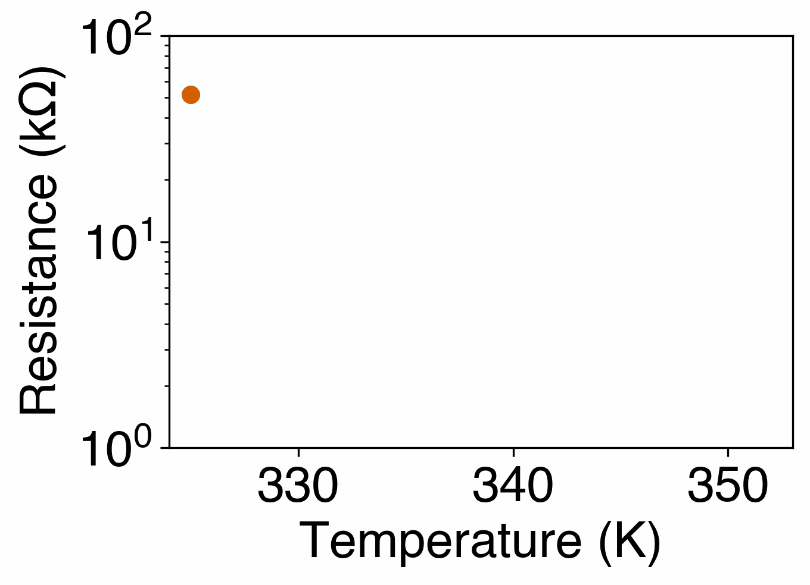
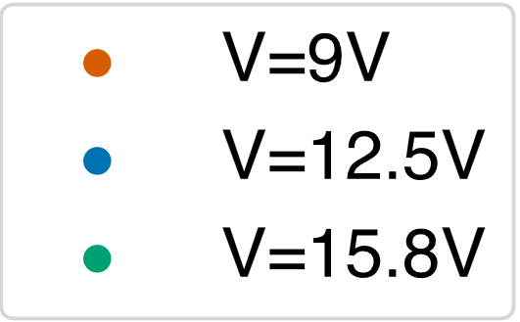
Single Neuristor Characteristics
V^{in}
R^{load}
V
R
C
Qiu, E., Zhang, Y. H., Di Ventra, M., & Schuller, I. K. (2023). Reconfigurable cascaded thermal neuristors for neuromorphic computing. Advanced Materials, 2306818.

Slide 9
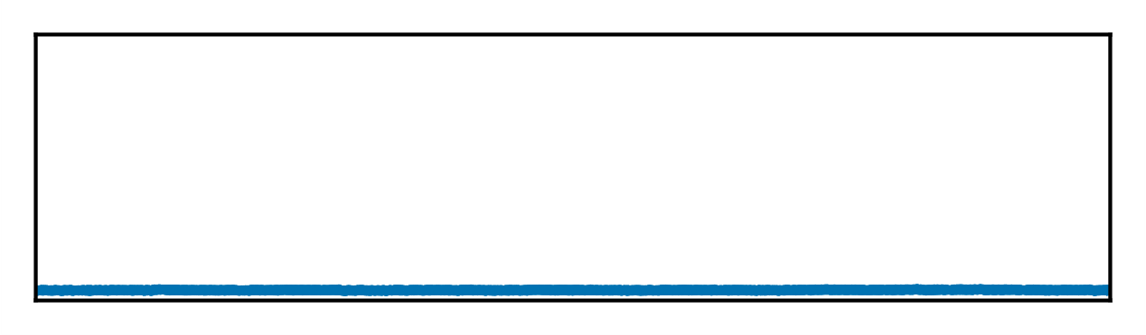

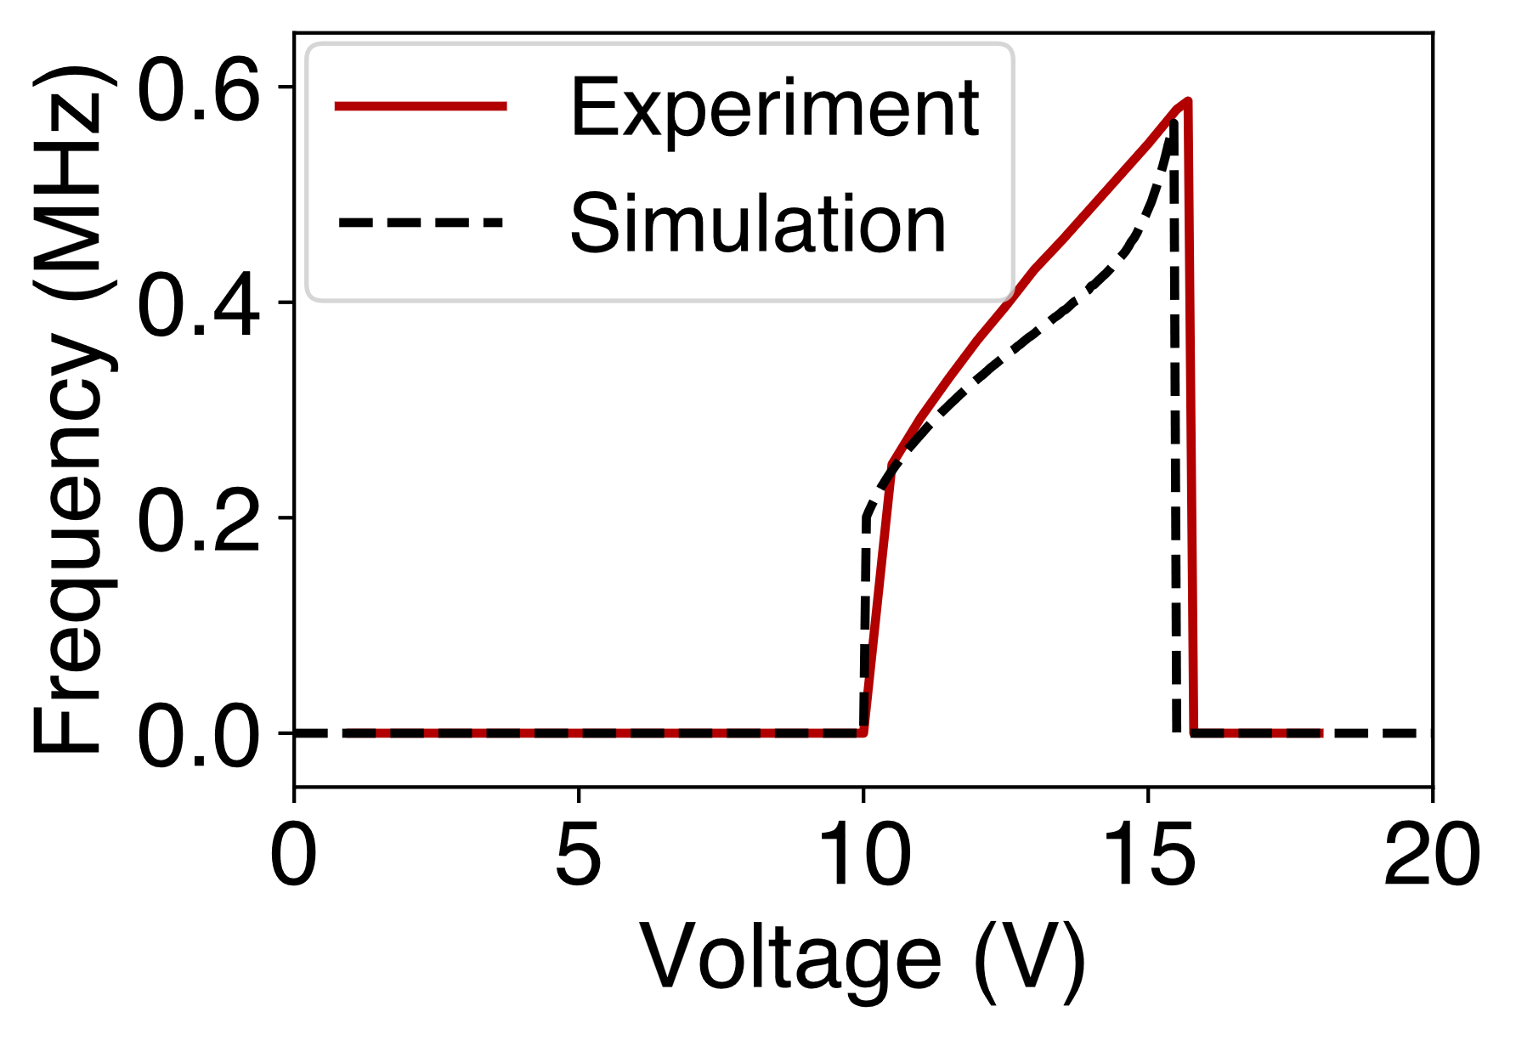
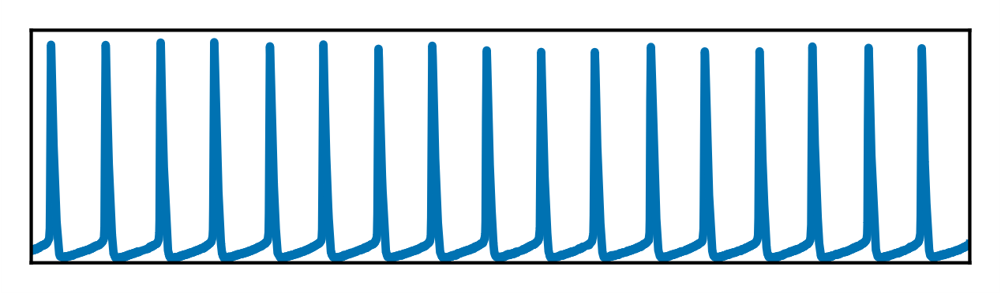
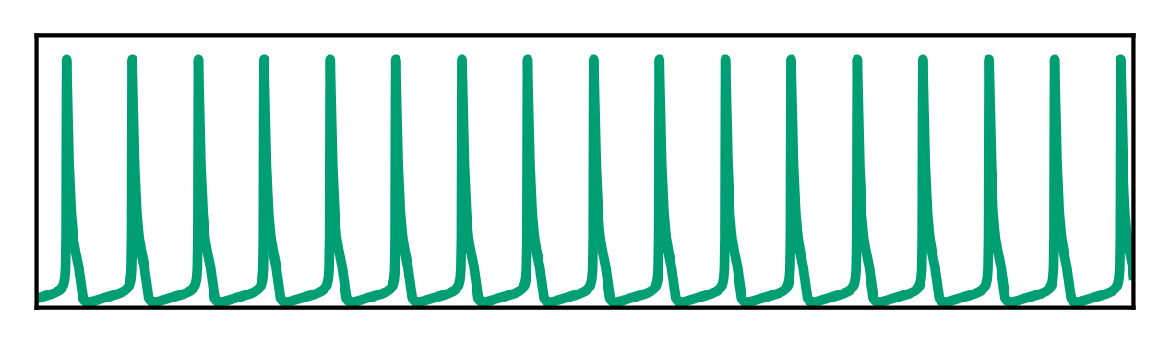
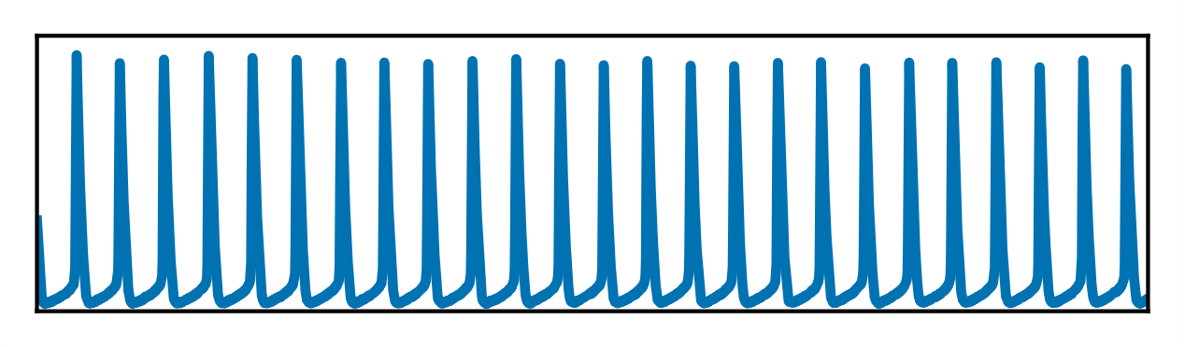
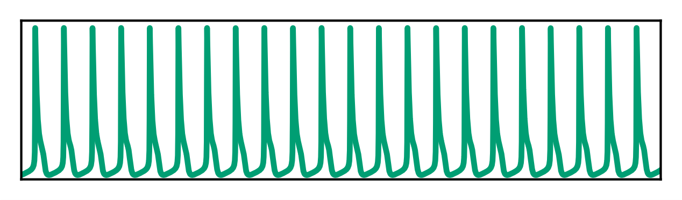
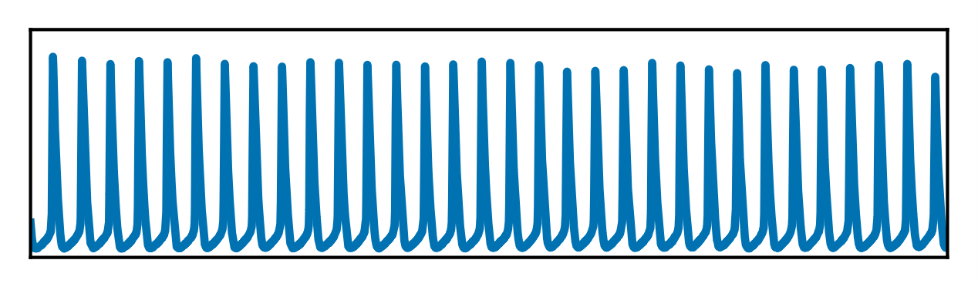
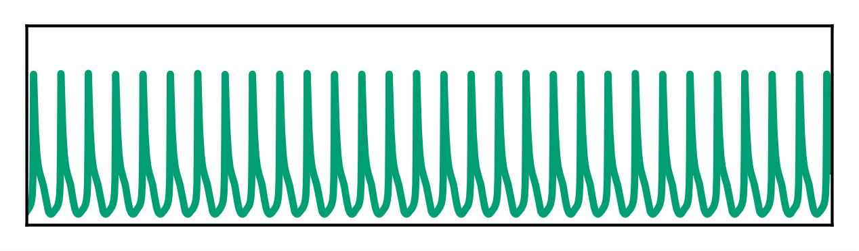
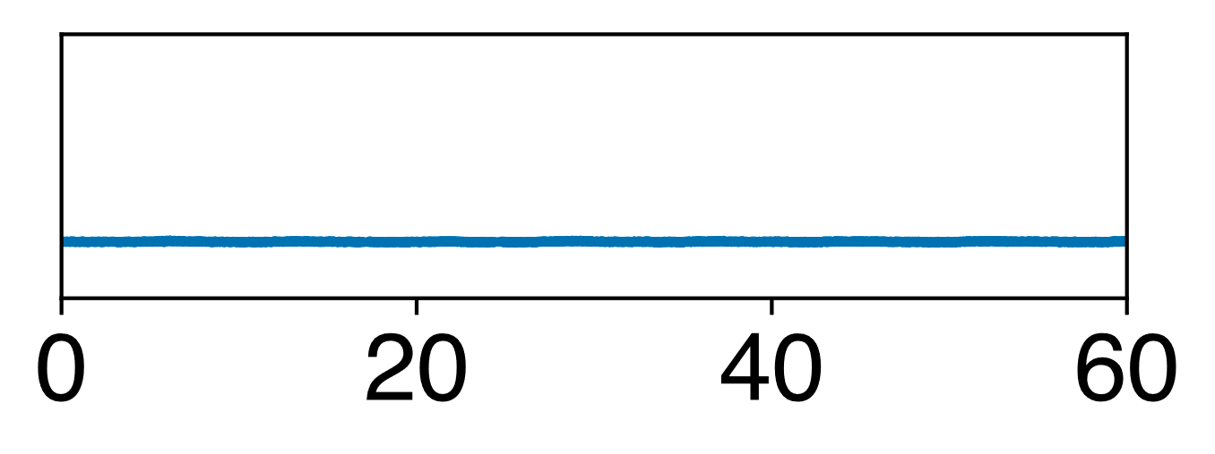
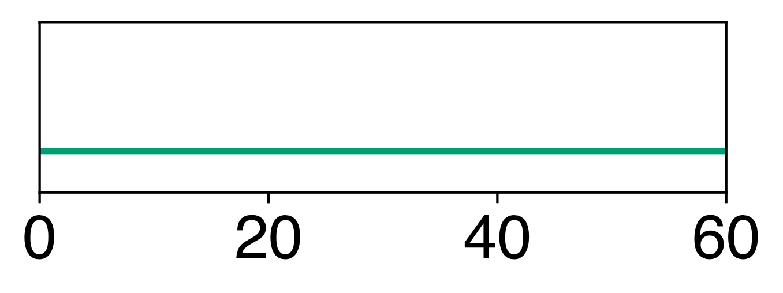


Single Neuristor Characteristics
Experiment
Simulation
V_{in}=9V
11V
Current
13V
15V
17V
0
20
40
60
0
20
40
60
Time ($μ$s)
Time ($μ$s)
Qiu, E., Zhang, Y. H., Di Ventra, M., & Schuller, I. K. (2023). Reconfigurable cascaded thermal neuristors for neuromorphic computing. Advanced Materials, 2306818.

Slide 10
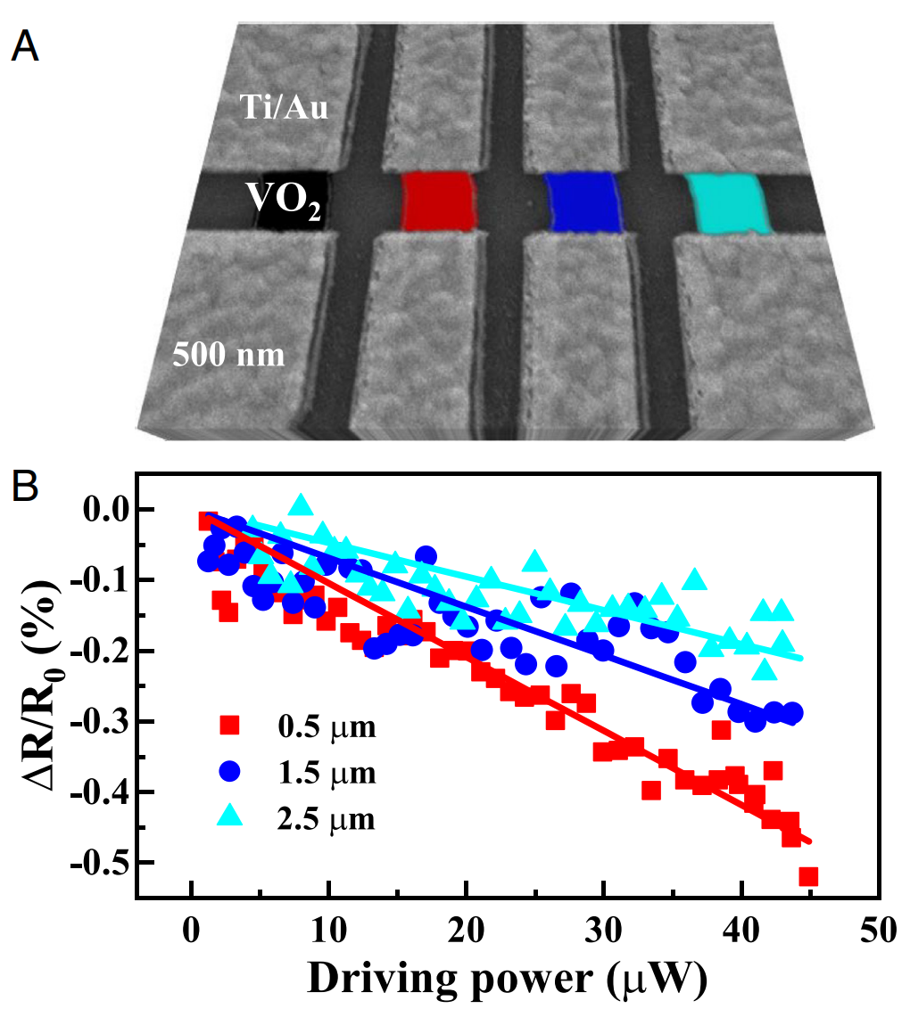
Thermal interactions
Heating
Electrically isolated
Heat propagation through Al₂O₃ substrate
Cooling
Qiu, E., Salev, P., Torres, F., Navarro, H., Dynes, R. C., & Schuller, I. K. (2023). Stochastic transition in synchronized spiking nanooscillators. Proceedings of the National Academy of Sciences, 120(38), e2303765120.

Slide 11
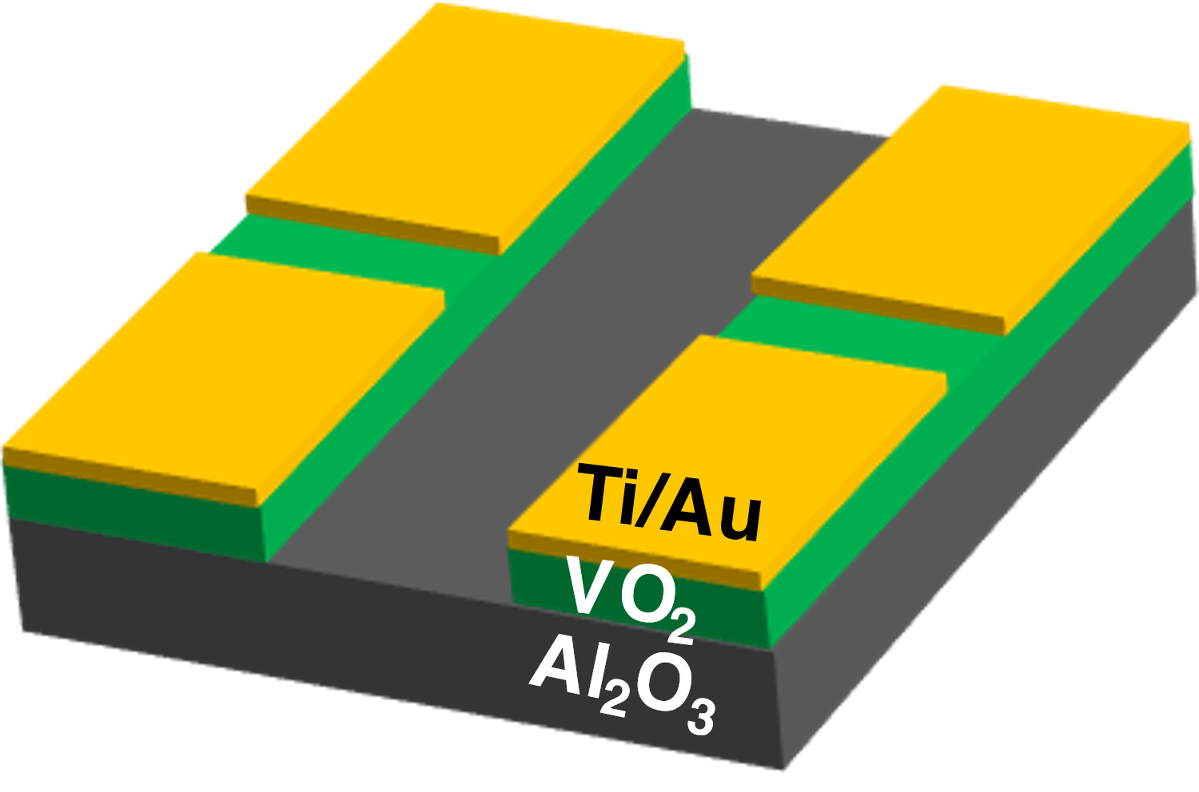
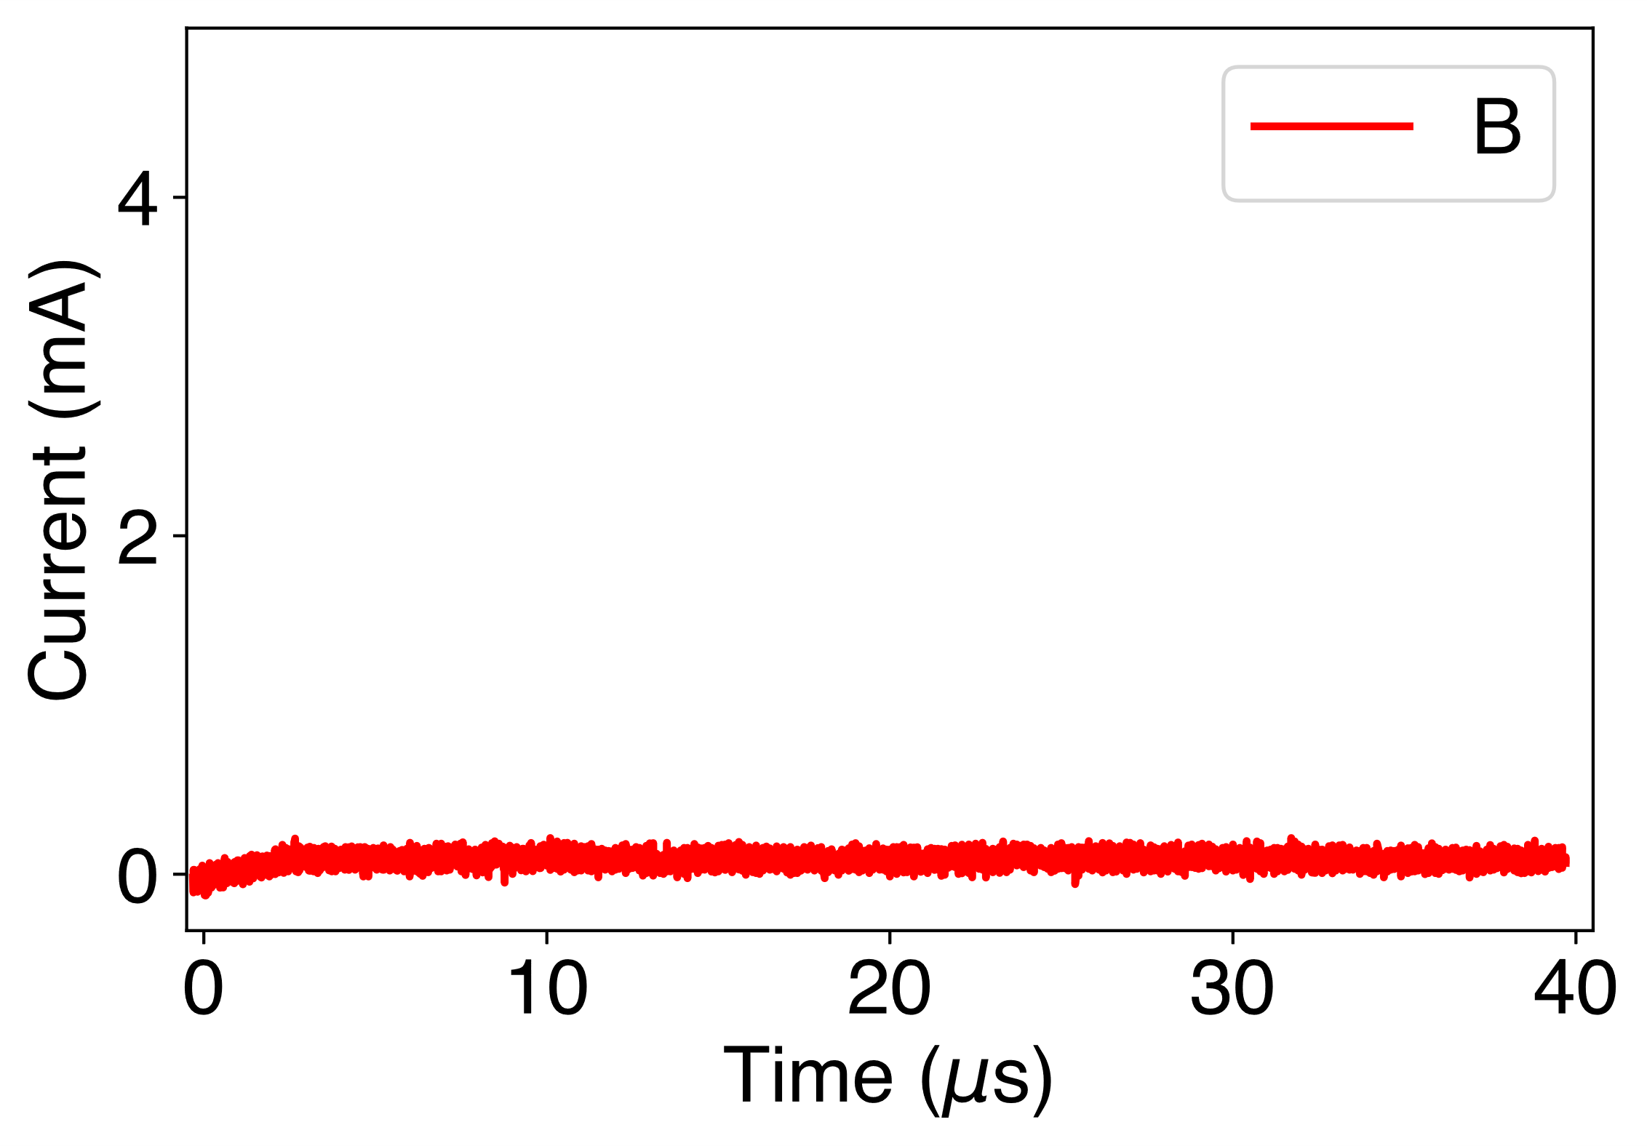
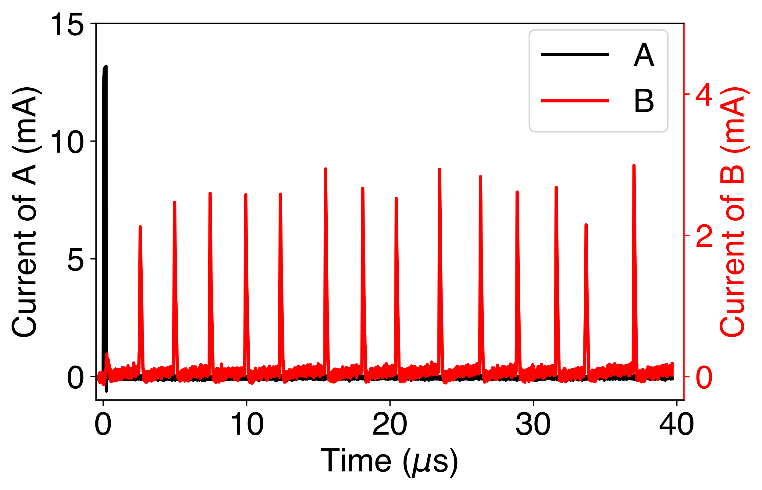
Thermal interactions
Thermally coupled
3.3V
A
Electrically Isolated
B
2.7V
Qiu, E., Zhang, Y. H., Di Ventra, M., & Schuller, I. K. (2023). Reconfigurable cascaded thermal neuristors for neuromorphic computing. Advanced Materials, 2306818.

Slide 12
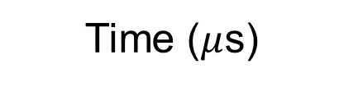

Excitatory and inhibitory interactions
Experiment
Simulation
V_{in}=9V
11V
Current
13V
Inhibitory
15V
Excitatory
17V
0
20
40
60
0
20
40
60
Time ($μ$s)
Time ($μ$s)
Qiu, E., Zhang, Y. H., Di Ventra, M., & Schuller, I. K. (2023). Reconfigurable cascaded thermal neuristors for neuromorphic computing. Advanced Materials, 2306818.

Slide 13
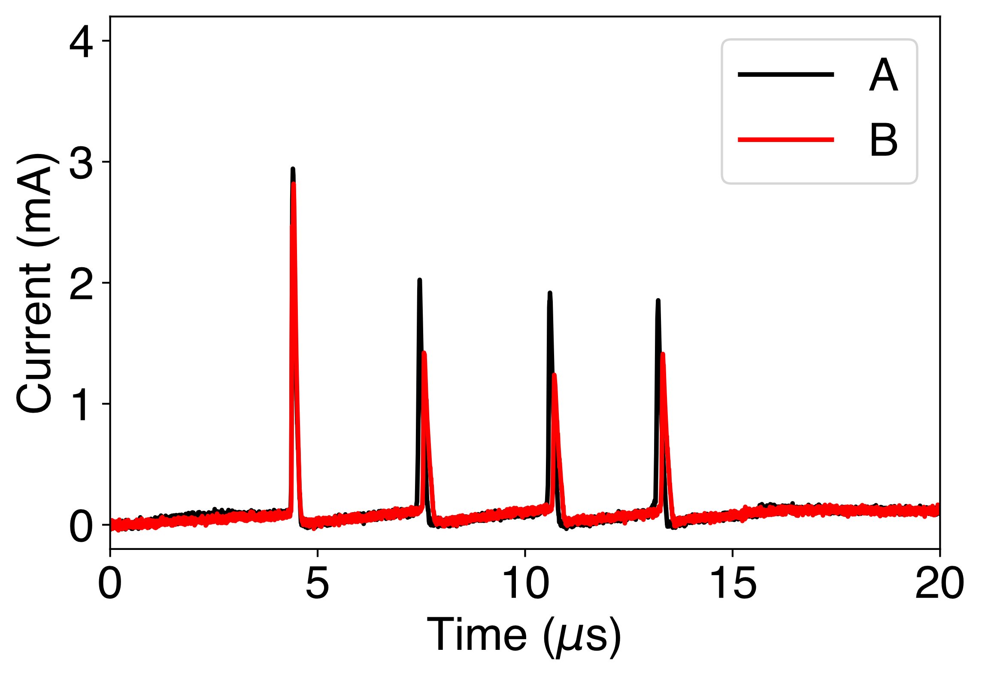
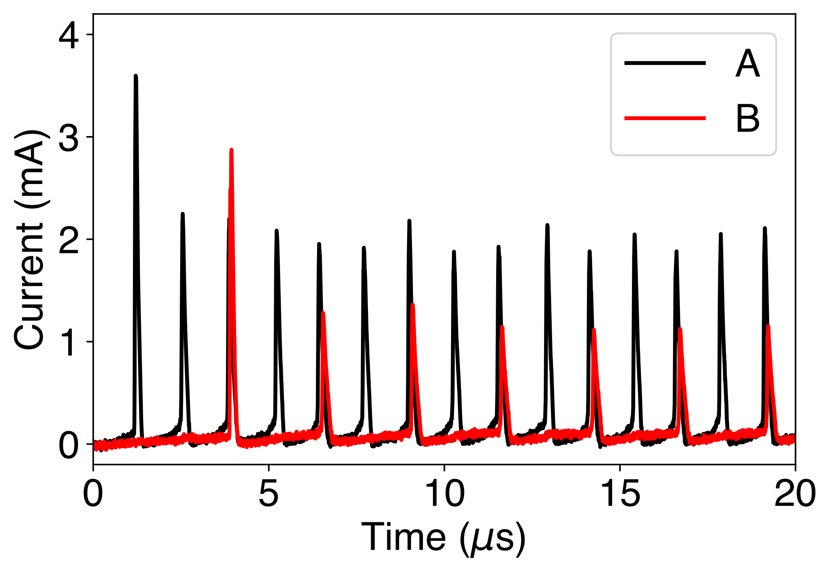
Excitatory interaction
Thermally coupled
A
Electrically Isolated
B
Qiu, E., Zhang, Y. H., Di Ventra, M., & Schuller, I. K. (2023). Reconfigurable cascaded thermal neuristors for neuromorphic computing. Advanced Materials, 2306818.

Slide 14
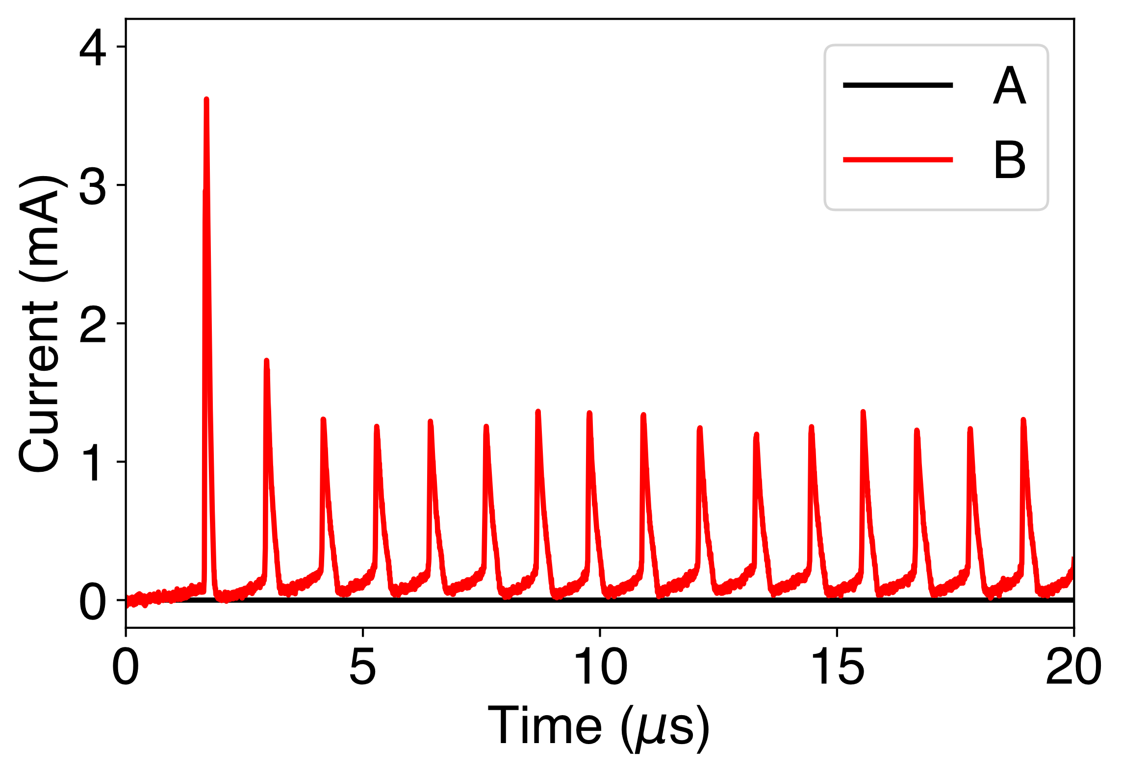
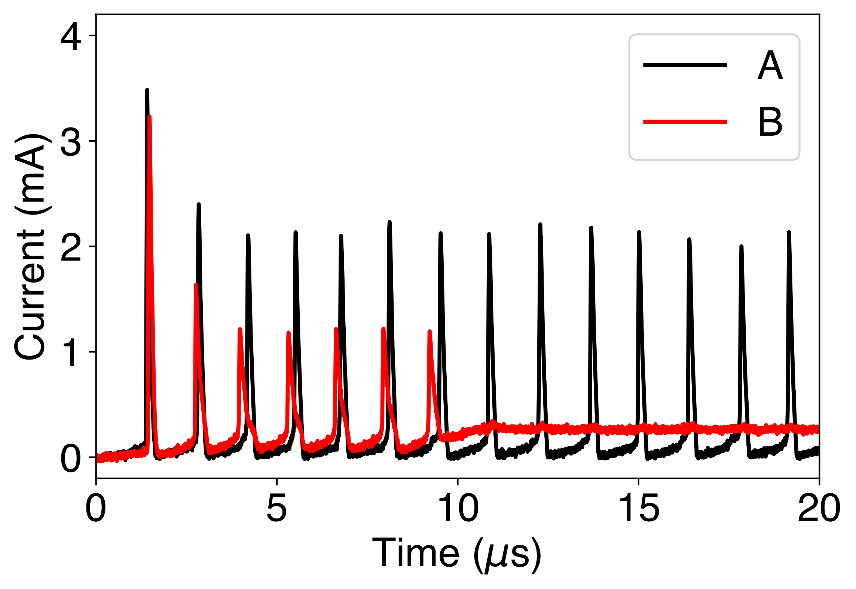
Inhibitory interaction
Thermally coupled
A
Electrically Isolated
B
Qiu, E., Zhang, Y. H., Di Ventra, M., & Schuller, I. K. (2023). Reconfigurable cascaded thermal neuristors for neuromorphic computing. Advanced Materials, 2306818.

Slide 15
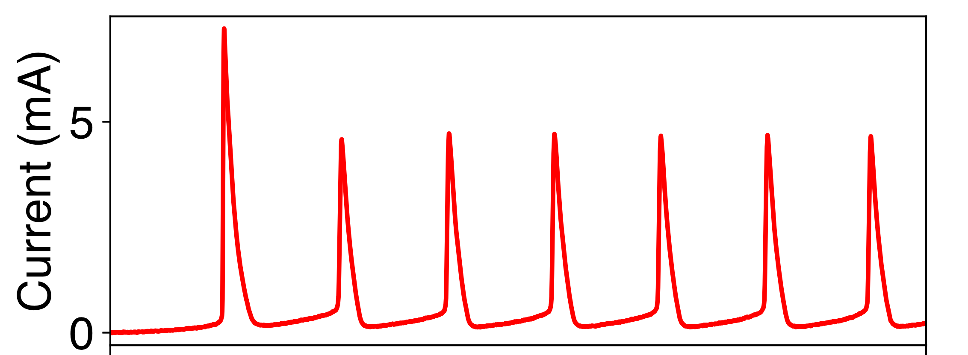
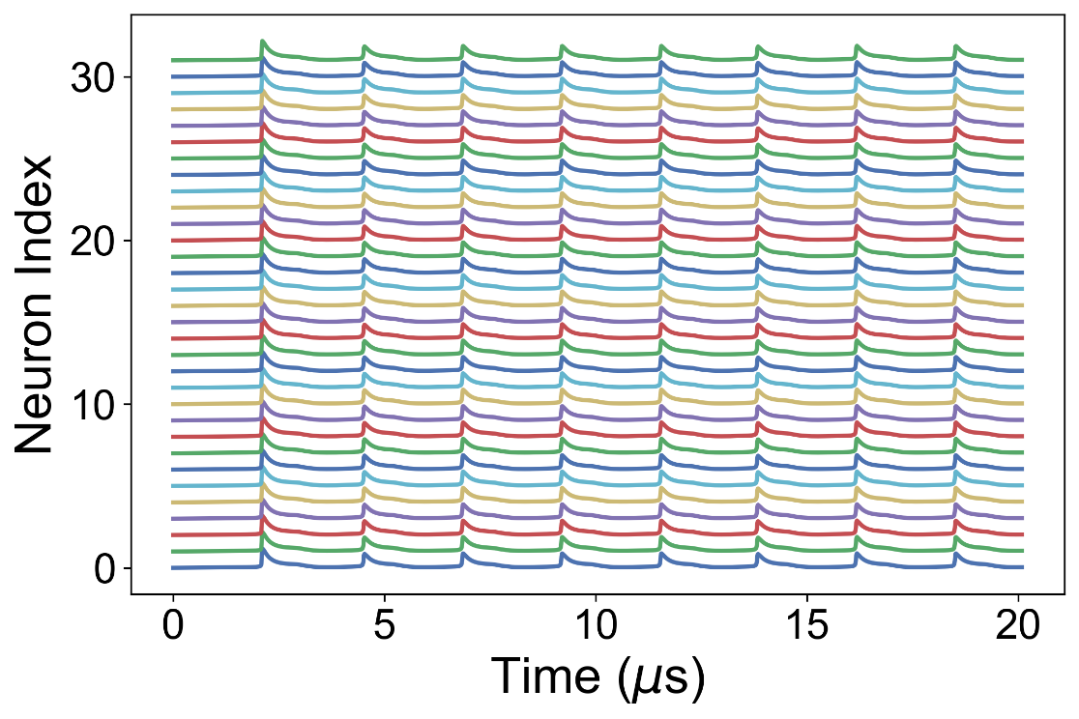
Thermal neuristor array
1 neuron
(experiment)
32 neurons
(simulation)

Slide 16
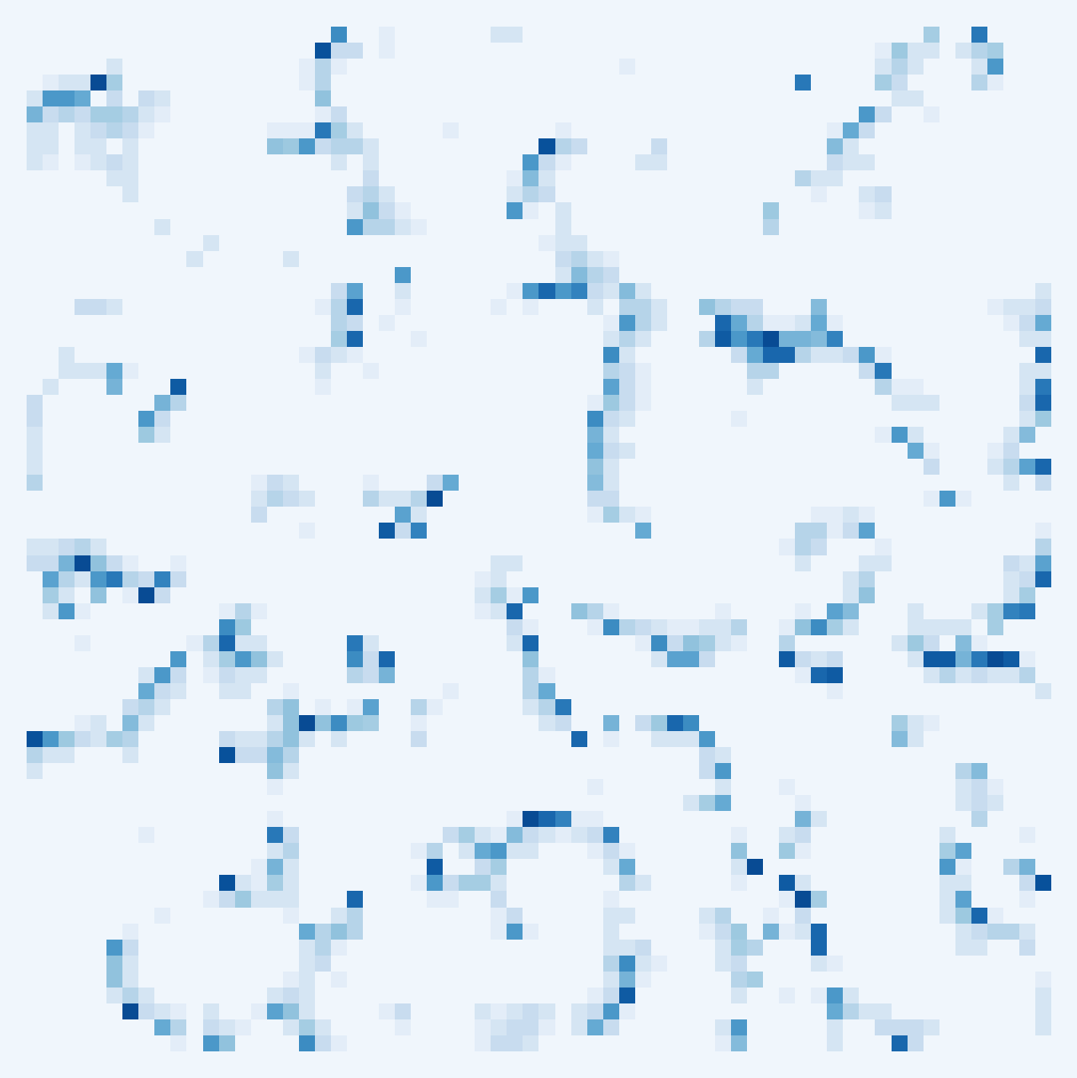
2D array
64x64
neurons

Slide 17



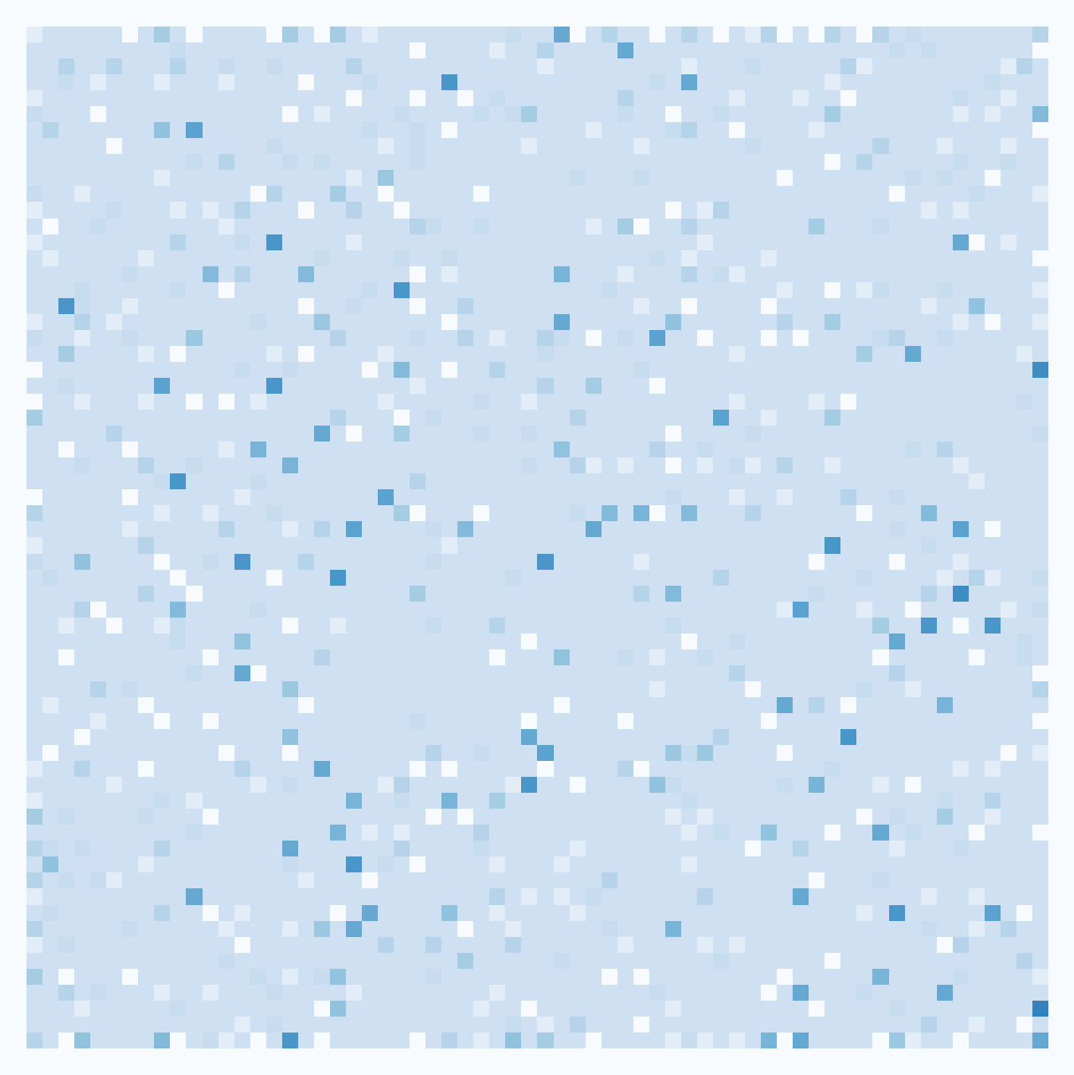
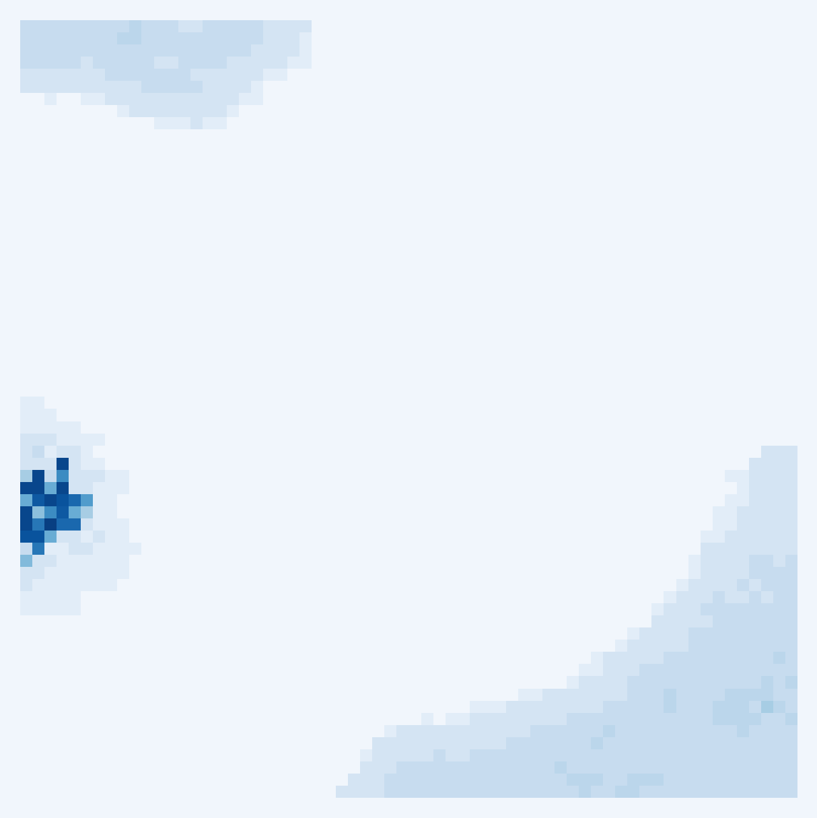


10
10.6
13.4
15
Voltage (V)
9
10.4
12
14
Zhang, Y. H., Sipling, C., Qiu, E., Schuller, I. K. and Di Ventra, M. (2023). Collective dynamics and long-range order in thermal neuristor networks. arXiv preprint arXiv:2312.12899

Slide 18


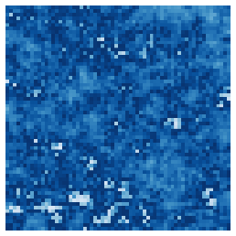
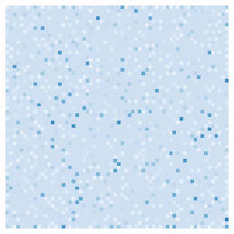
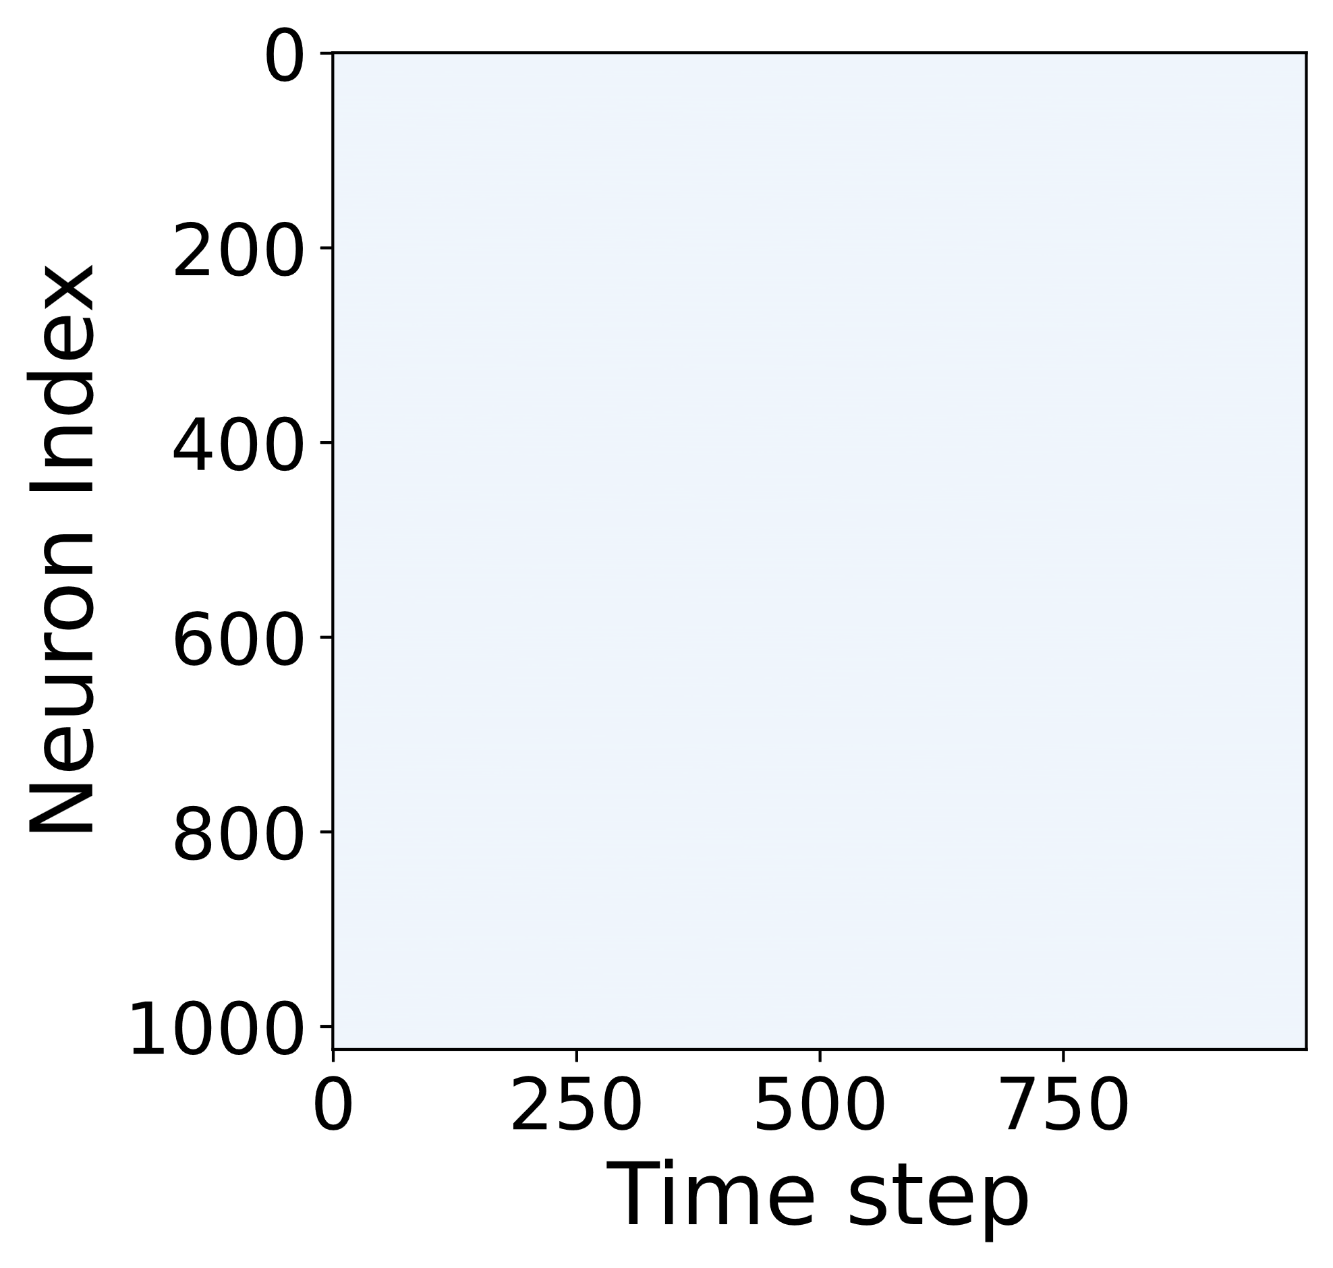
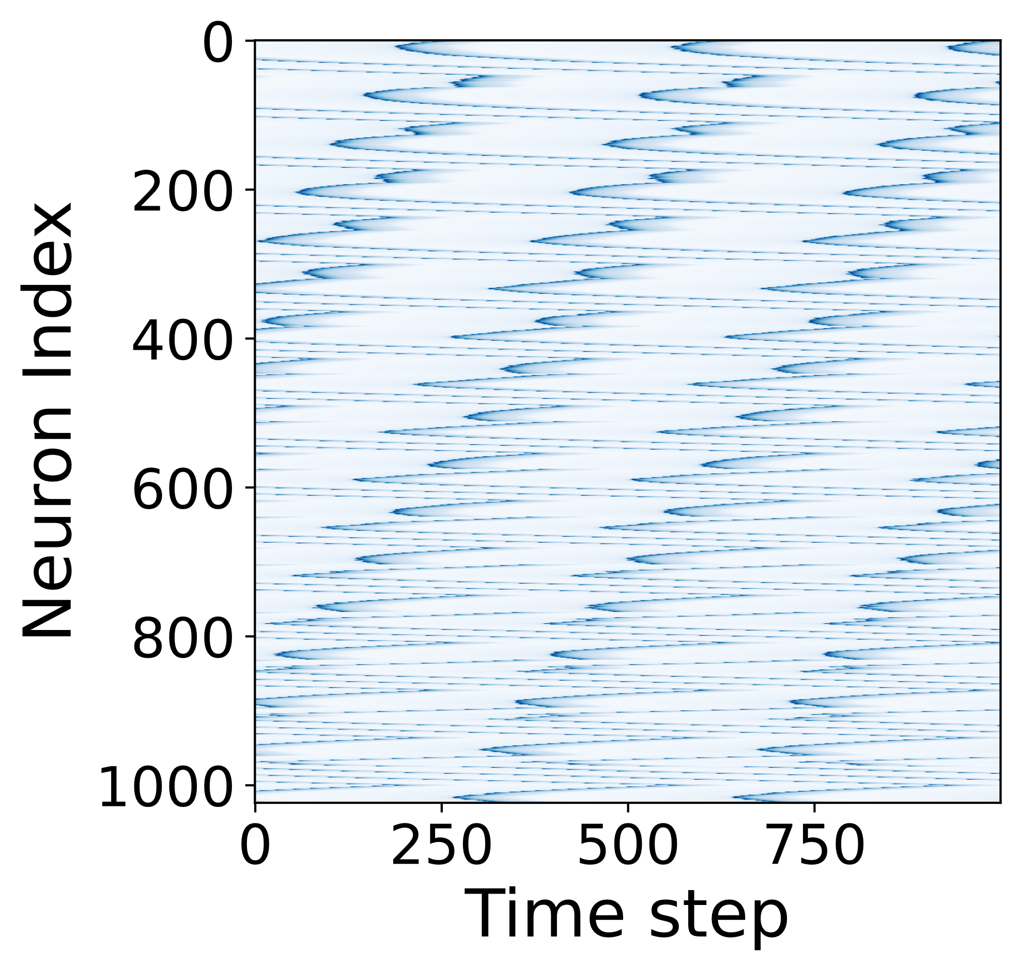
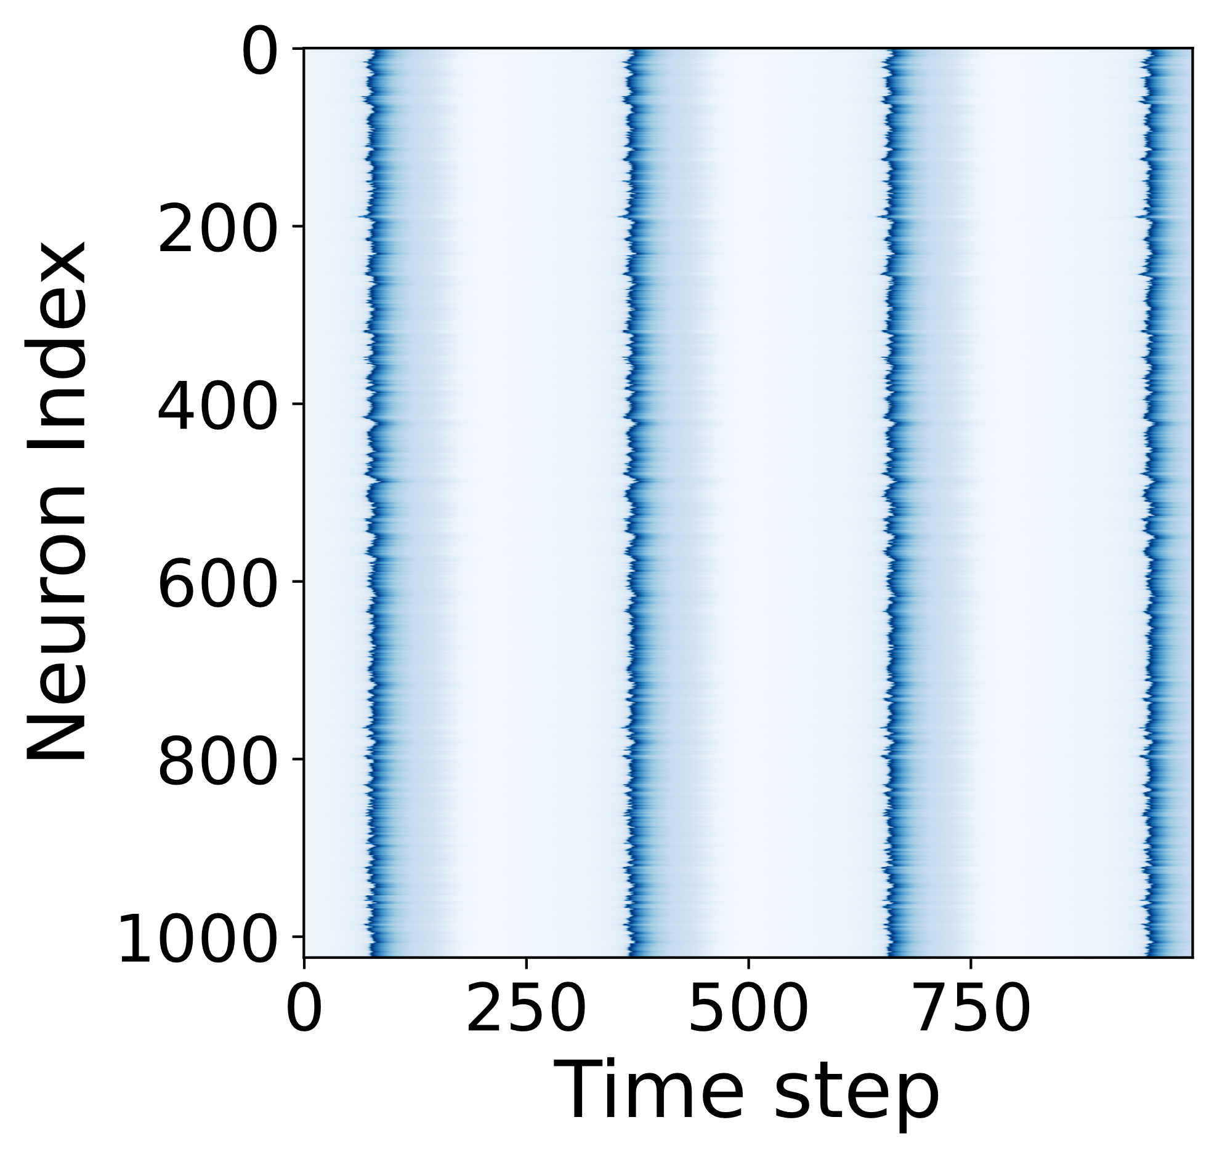
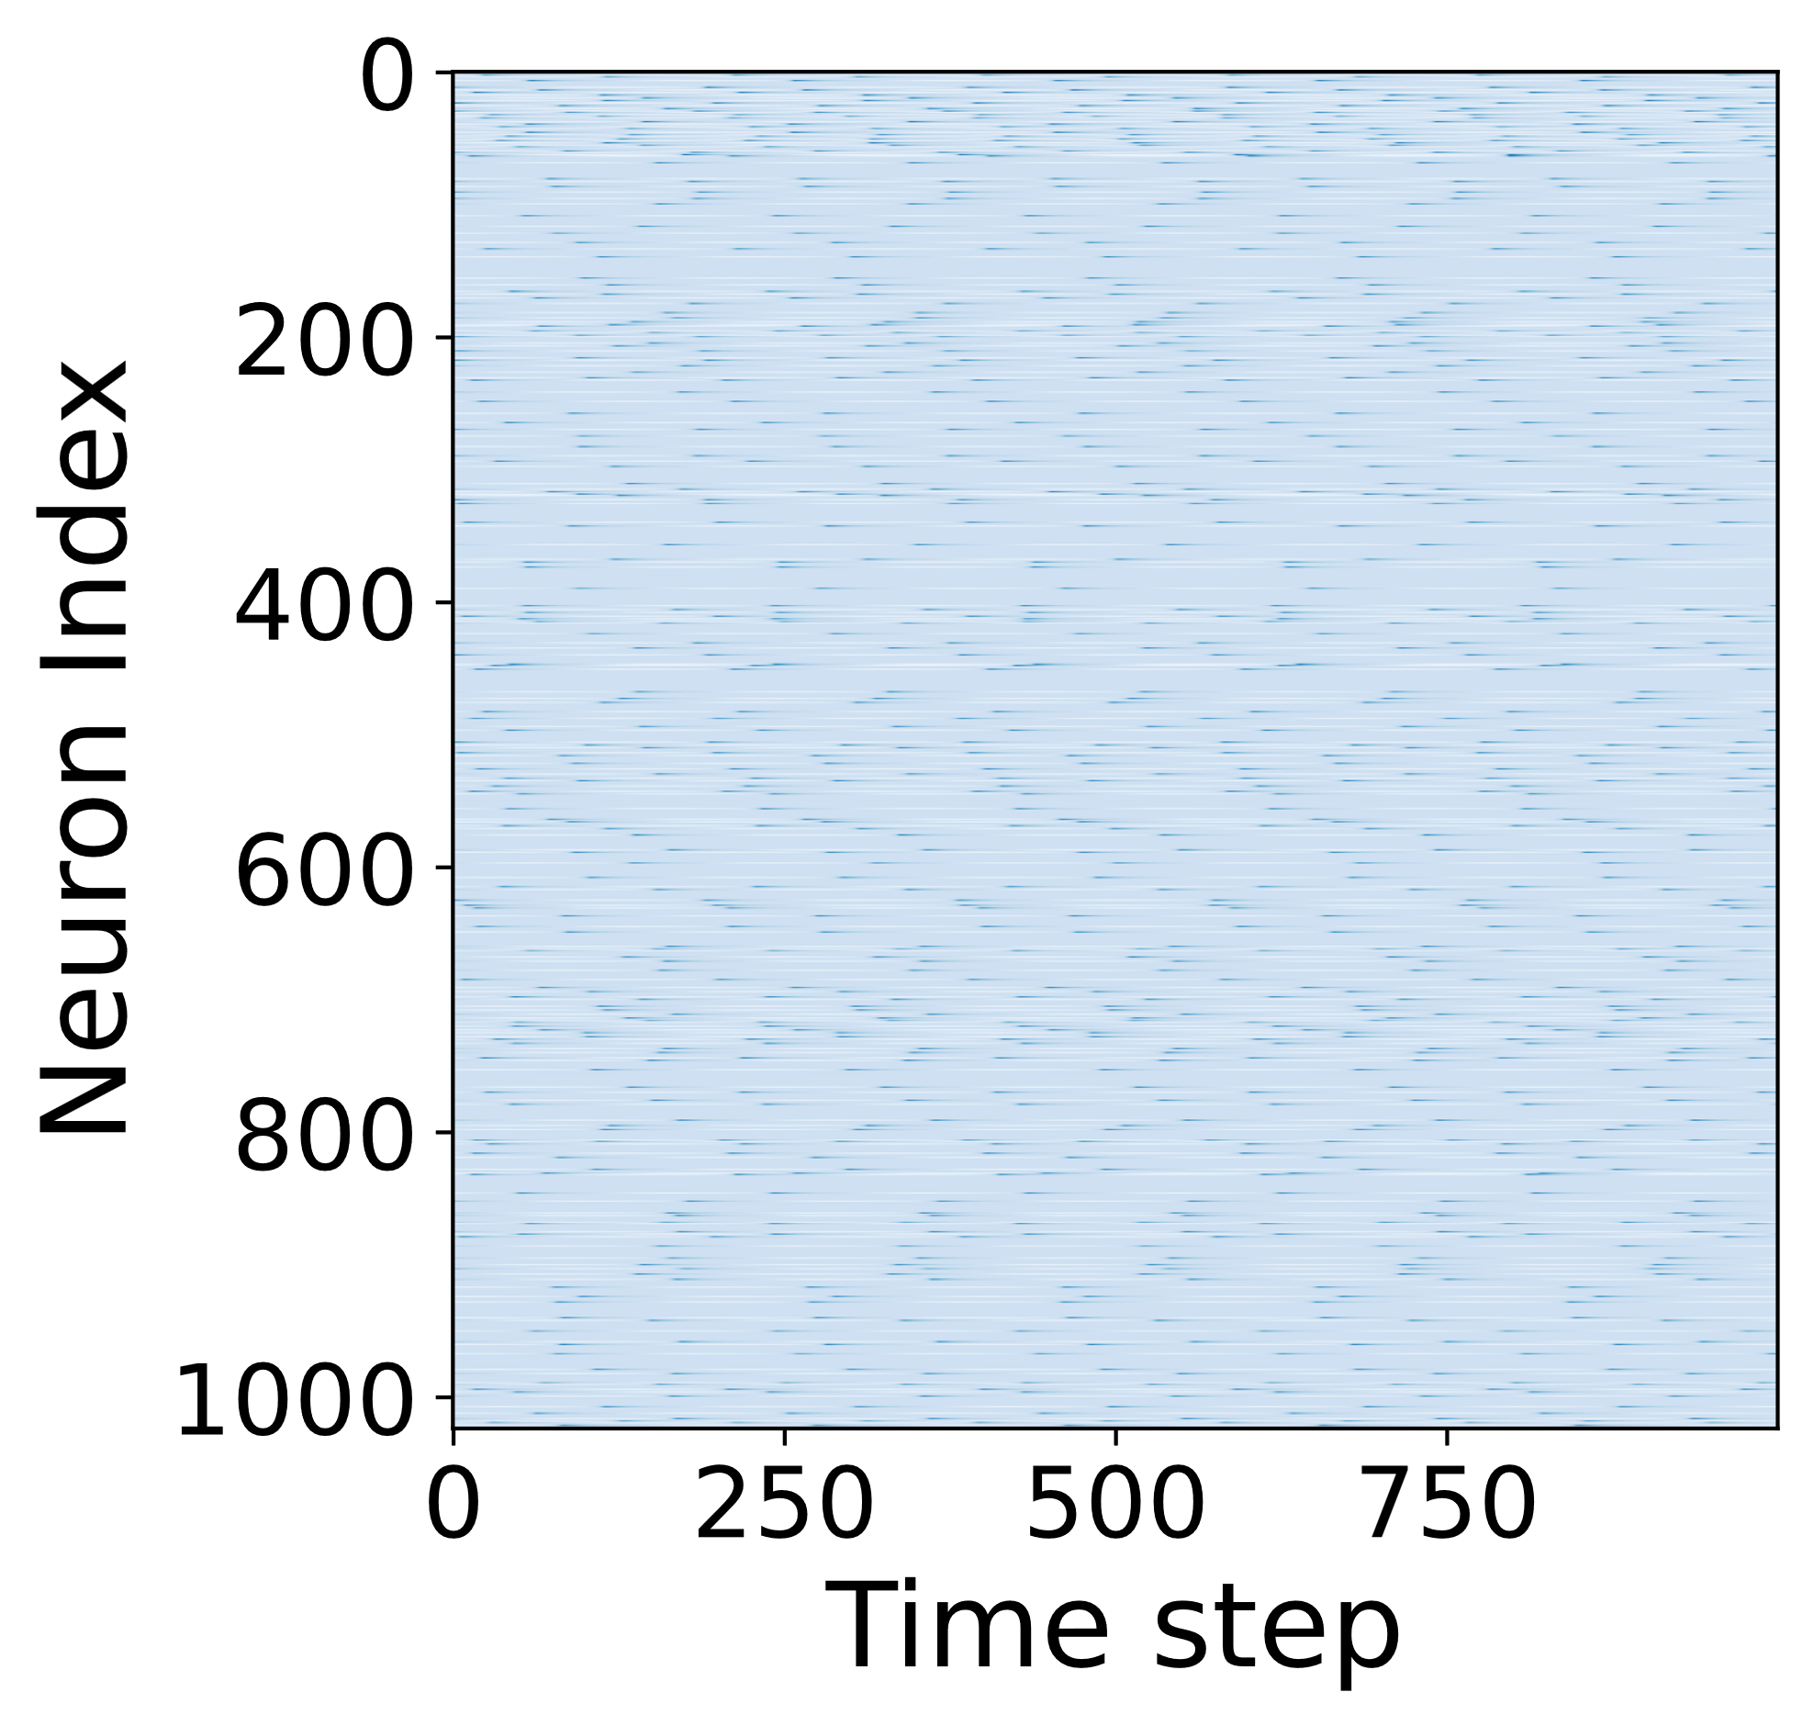
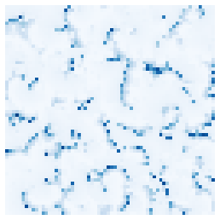
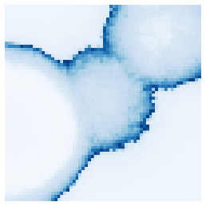
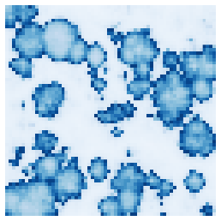

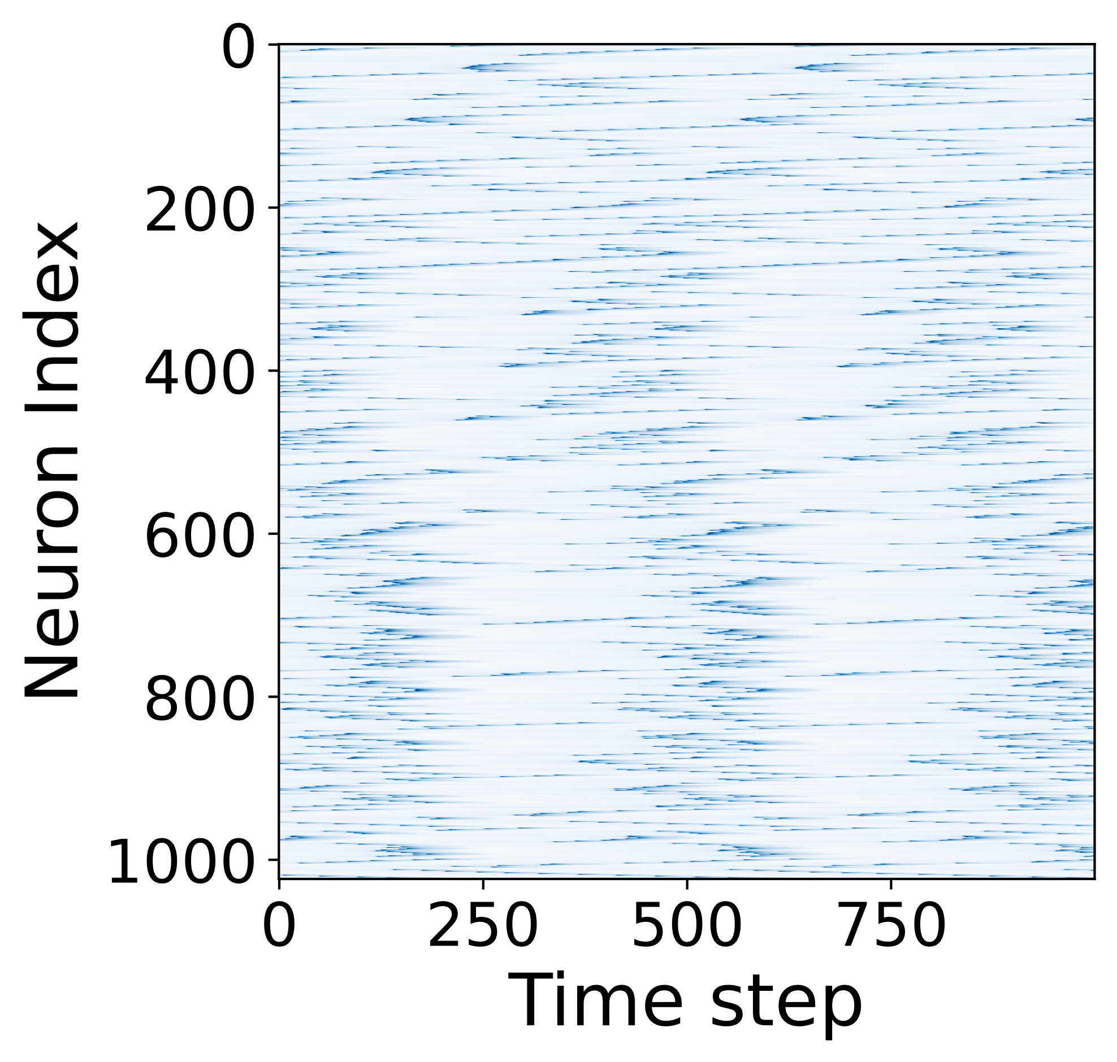
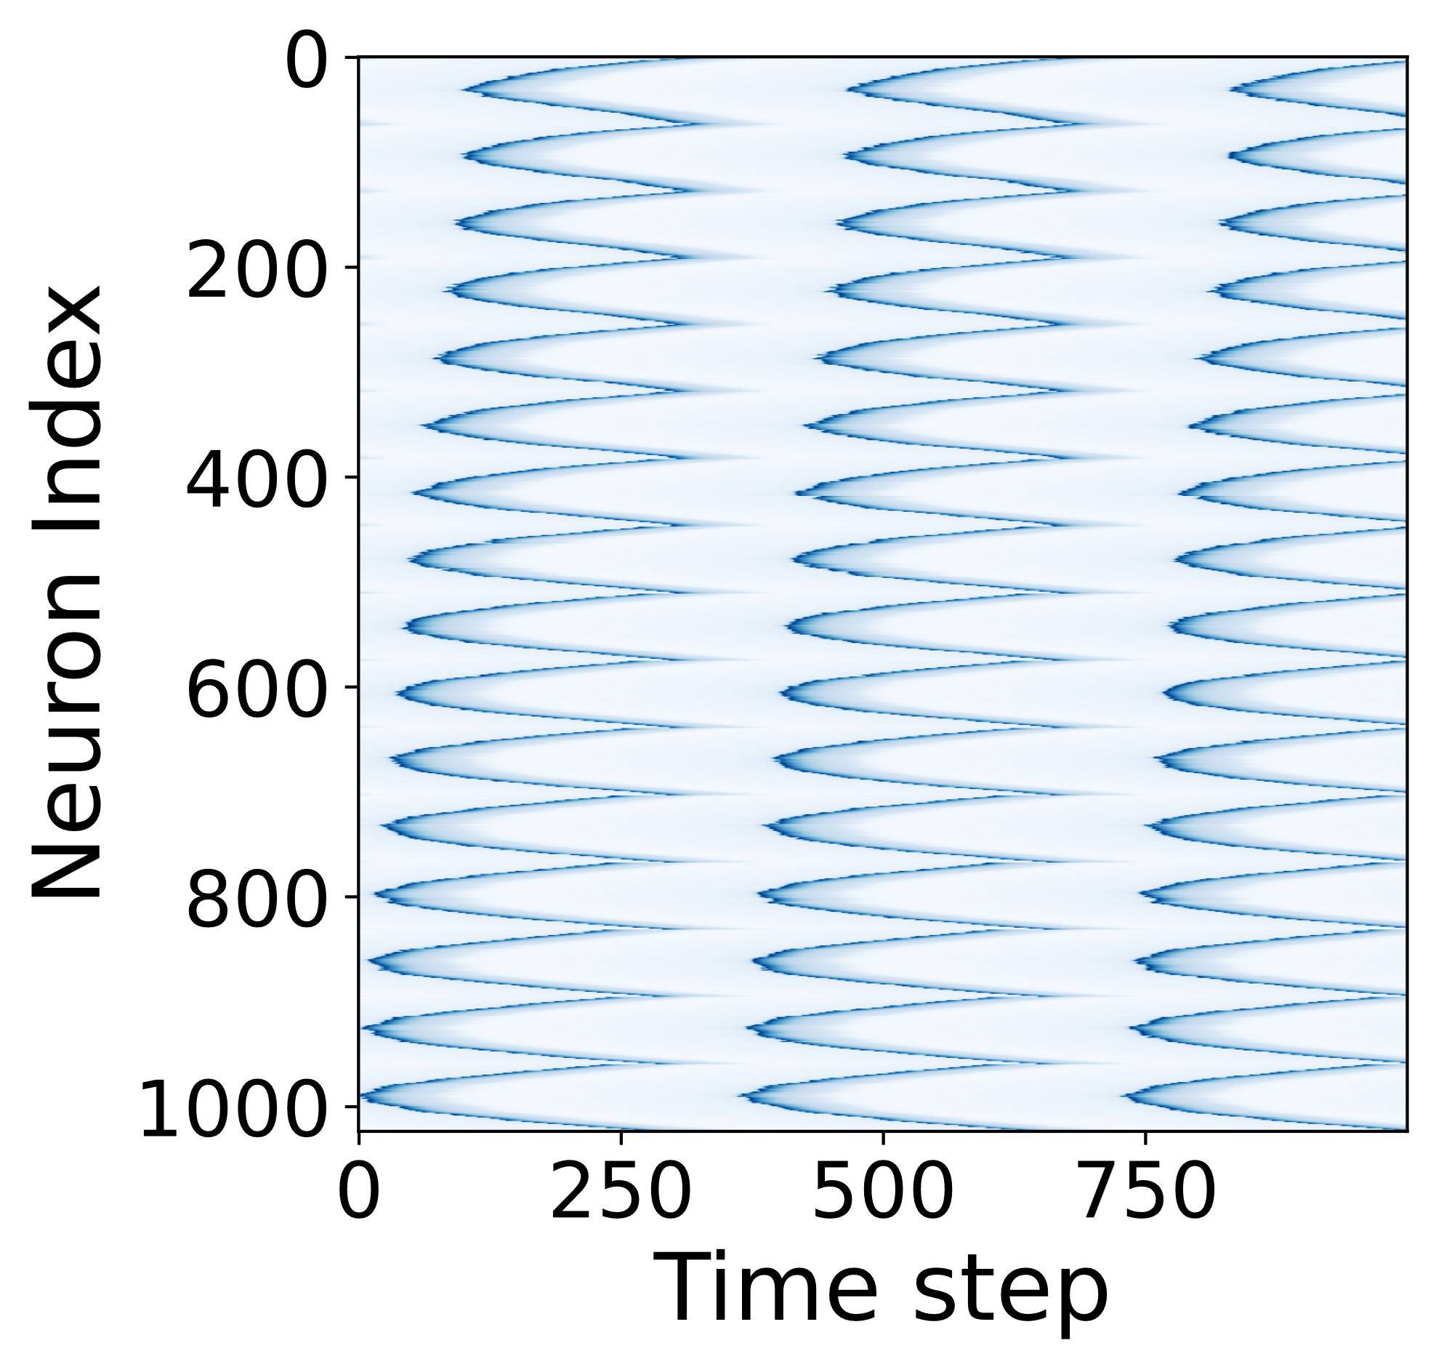
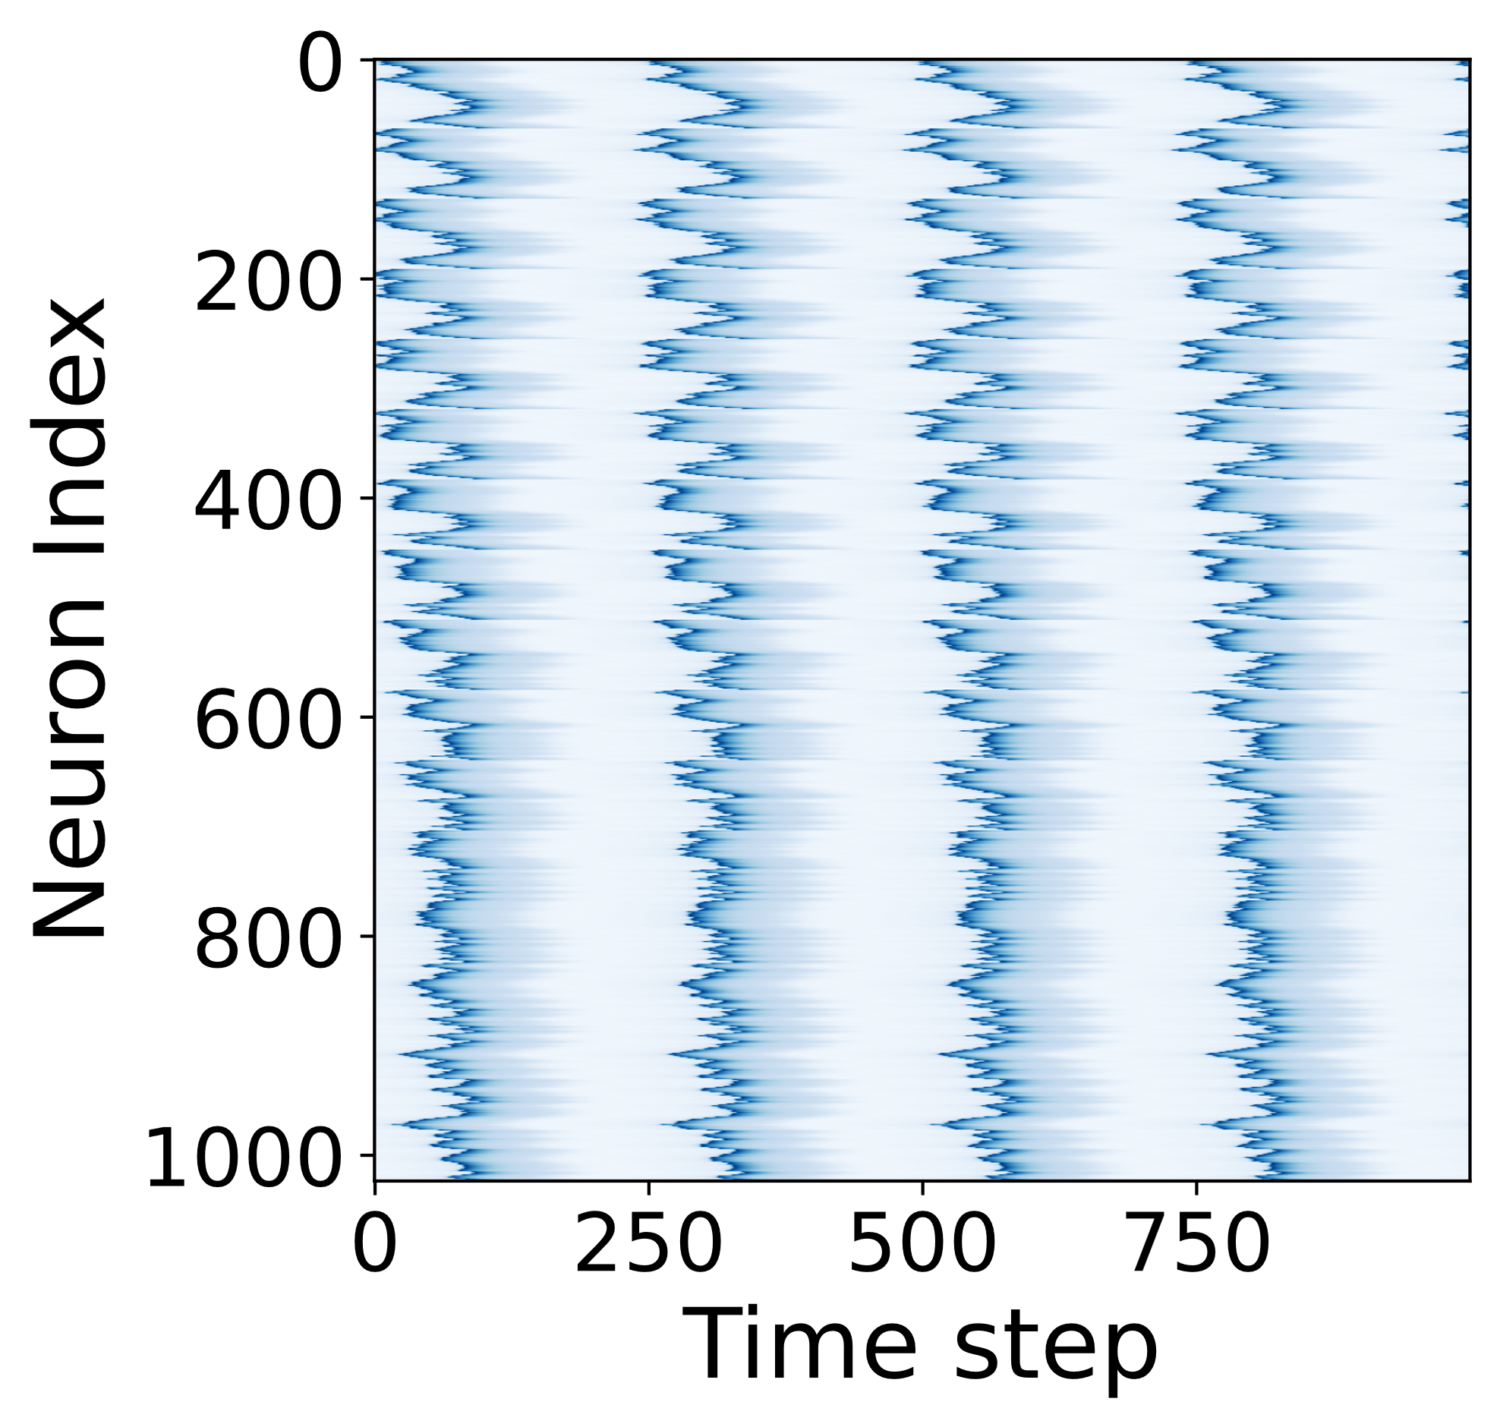

10
10.6
13.4
15
Voltage (V)
9
10.4
12
14
Y.-H. Zhang, C. Sipling, E. Qiu, I. K. Schuller, M. Di Ventra, (2023). Collective dynamics and long-range order in thermal neuristor networks. arXiv preprint arXiv:2312.12899

Slide 19


Long-range order?
V^{in}
$$C\frac{dV}{dt}=\frac{V_{in}}{R_{load}}−V\left(\frac{1}{R_{VO_{2}}}+\frac{1}{R_{load}}\right)$$
R^{load}
$C_{th}\frac{dT}{dt}=\frac{V^{2}}{R_{VO_{2}}}−S_{env}\left(T−T_{0}\right)$ $+S_{couple}∇^{2}T+η(t)$
Thermal diffusion
V
R
C
$$⋯⋯$$

Slide 20

Long-range order?
V^{in}
$$C\frac{dV}{dt}=\frac{V_{in}}{R_{load}}−V\left(\frac{1}{R_{VO_{2}}}+\frac{1}{R_{load}}\right)$$
R^{load}
$C_{th}\frac{dT}{dt}=\frac{V^{2}}{R_{VO_{2}}}−S_{env}\left(T−T_{0}\right)$ $+S_{couple}∇^{2}T+η(t)$
V
R
C

Slide 21


Self-organized criticality
Sandpile model:
Self-organized criticality
Thermal neuristors
Image credit: https://runestone.academy/ns/books/published/complex/SelfOrganizedCriticality/ImplementingTheSandPile.html
Bak, Per, Chao Tang, and Kurt Wiesenfeld. "Self-organized criticality: An explanation of the 1/f noise." Physical review letters 59.4 (1987): 381.
Hesse, Janina, and Thilo Gross. "Self-organized criticality as a fundamental property of neural systems." Frontiers in systems neuroscience 8 (2014): 166.

Slide 22


Long-range order?
Fast spiking dynamics
$$C\frac{dV_{1}}{dt}=\frac{V_{in}}{R_{load}}−V_{1}\left(\frac{1}{R_{VO_{2}}}+\frac{1}{R_{load}}\right)$$
$$C_{th}\frac{dT}{dt}=\frac{V_{1}^{2}}{R_{VO_{2}}}−S_{env}\left(T−T_{0}\right)+S_{couple}∇^{2}T+η(t)$$
Slow memory dynamics

Slide 23

Long-range order?
Fast spiking dynamics
$$C\frac{dV_{1}}{dt}=\frac{V_{in}}{R_{load}}−V_{1}\left(\frac{1}{R_{VO_{2}}}+\frac{1}{R_{load}}\right)$$
Time scale
$$C_{th}\frac{dT}{dt}=\frac{V_{1}^{2}}{R_{VO_{2}}}−S_{env}\left(T−T_{0}\right)+S_{couple}∇^{2}T+η(t)$$
Slow memory dynamics

Slide 24




Avalanche size distribution
$$V=9.96V, C_{th}=1$$
$$∼s^{−1.58}$$
Zhang, Y. H., Sipling, C., Qiu, E., Schuller, I. K. and Di Ventra, M. (2023). Collective dynamics and long-range order in thermal neuristor networks. arXiv preprint arXiv:2312.12899

Slide 25








$$∼s^{−1.58}$$
$$∼s^{−3.56}$$
Long-range Order
Phase Boundary
Rigid State
No Activity

Slide 26








Application: MNIST
Input
Dynamics
Prediction: 3
Fully-connected
output layer
Zhang, Y. H., Sipling, C., Qiu, E., Schuller, I. K. and Di Ventra, M. (2023). Collective dynamics and long-range order in thermal neuristor networks. arXiv preprint arXiv:2312.12899

Slide 27

Reservoir Computing

Slide 28
Conclusions
Spiking oscillators utilizing insulator-to-metal transition in VO₂
Interactions mirroring biological neurons
Phase of long-range order
Application: reservoir computing

Slide 29

Thank you!
E.Qiu, P. Salev, F. Torres, H. Navarro, R. C. Dynes, & I. K. Schuller, (2023). Stochastic transition in synchronized spiking nanooscillators. Proceedings of the National Academy of Sciences, 120(38), e2303765120.
E. Qiu, Y.-H. Zhang, M. Di Ventra, I. K. Schuller, Reconfigurable cascaded thermal neuristors for neuromorphic computing. Advanced Materials, 2306818.
Y.-H. Zhang, C. Sipling, E. Qiu, I. K. Schuller, M. Di Ventra, Collective dynamics and long-range order in thermal neuristor networks. arXiv preprint arXiv:2312.12899

